Slide 1
CE6404 SURVEYING II LTPC
3 0 0 3
OBJECTIVES:
• This subject deals with geodetic measurements and Control Survey methodology and
its adjustments. The student is also exposed to the Modern Surveying.
UNIT I
CONTROL SURVEYING
9
Horizontal and vertical control - Methods - specifications - triangulation- baseline - instruments and
accessories - corrections - satellite stations - reduction to centre- trigonometrical levelling - single
and reciprocal observations - traversing - Gale‟ s table.
UNIT II
SURVEY ADJUSTMENT
9
Errors Sources- precautions and corrections - classification of errors - true and most probable
Values- weighed observations - method of equal shifts -principle of least squares -0 normal
Equation - correlates- level nets- adjustment of simple triangulation networks.
UNIT III
TOTAL STATION SURVEYING
9
Basic Principle
- Classifications
-Electro-optical system: Measuring principle, Working
Principle, Sources of Error, Infrared and Laser Total Station instruments, Microwave system:
Measuring principle, working principle, Sources of Error, Microwave Total Station instruments. Comparis on between Electro-optical and Microwave system. Care and maintenance of Total Station instruments. Modern positioning systems - Traversing and Trilateration.
UNIT IV GPS SURVEYING 9
Basic Concepts - Different segments - space, control and user segments - satellite configuration - signal structure - Orbit determination and representation - Anti Spoofing and Selective Availability
- Task of control segment - Hand Held and Geodetic receivers -data processing - Traversing and Triangulation.
UNIT V
ADVANCED TOPICS IN SURVEYING
9
Route Surveying - Reconnaissance - Route surveys for highways, railways and waterways - Simple curves - Compound and reverse curves - Setting out Methods - Transition curves -
Functions and requirements - Setting out by offsets and angles - Vertical curves - Sight distances- hydrographic surveying - Tides - MSL - Sounding methods - Three-point problem - Strength of fix
- Sextants and station pointer- Astronomical Surveying - field observations and determination of Azimuth by altitude and hour angle methods- fundamentals of Photogrammetry and
Remote Sensing
TOTAL: 45 PERIODS
OUTCOMES:
On completion of this course students shall be able to understand the advantages of electronic
surveying over conventional surveying methods
•
Understand the working principle of GPS, its components, signal structure, and error
•
sources
•
Understand various GPS surveying methods and processing techniques used in GPS
observations
TEXT BOOKS:
1. James M. Anderson and Edward M. Mikhail, "Surveying, Theory and Practice",
7th Edition, McGraw Hill, 2001.
2.
Bannister and S. Raymond, "Surveying", 7th Edition, Longman 2004.
3.
Laurila, S.H. "Electronic Surveying in Practice", John Wiley and Sons Inc, 1993
REFERENCES:
1.
Alfred Leick, "GPS satellite surveying", John Wiley & Sons Inc., 3rd Edition, 2004.
2.
Guocheng Xu, " GPS Theory, Algorithms
and Applications", Springer - Berlin, 2003.
3.
Satheesh Gopi, rasathishkumar, N. madhu,
“Advanced Surveying, Total Station GPS and
www.Vidyarthiplus.com

Slide 2
TABLE OF CONTENTS
S.NO
TOPICS
PAGE
1
CHAPTER 1(CONTROL SURVEYING)
NO
1.1
HORIZONTAL CONTROLS & ITS METHODS
1
1.2
VERTICAL CONTROL & ITS METHODS
1
1.3
CLASSIFICATION OF TRIANGULATION SYSTEM
5
1.3.1
FIRST ORDER OR PRIMARY TRIANGULATION
5
1.3.2
SECONDARY ORDER OR SECONDARY TRIANGULATION
6
1.3.3
THIRD ORDER OR TERTIARY TRIANGULATION
7
2
CHAPTER 2
2.1
SURVEY ADJUSTMENTS
9
2.2
TYPES OF ERROR
THE LAW OF ACCIDENTAL ERRORS
10
2.3
PRINCIPLES OF LEAST SQUARES
10
2.4
LAW OF WEIGHTS
10
2.5
DISTRIBUTION OF ERROR OF THE FIELD MEASUREMENT
12
3
CHAPTER 3
BASIC PRINCIPLE
TOTAL STATION
13
3.1
3.2
CLASSIFICATION OF TOTAL STATIONS
14
3.2.1
LASER DISTANCE MEASUREMENT
16
3.2.2
ELECTRO- OPTICAL SYSTEM
3.3
FEATURES OF TOTAL STATIONS
22
3.5
SOFTWARE APPLICATIONS
27
3.6
SOURCES OF ERROR FOR TOTAL STATIONS
31
CHAPTER 4
GPS SURVEYING
4.1
INTRODUCTION
40
4.2
SEGMENTS OF GPS
40
4.3
SPACE SEGMENT
41
4.4
OBSERVATION PRINCIPLE AND SIGNAL
43
STRUCTURE
www.Vidyarthiplus.com

Slide 3
4.5
STRUCTURE OF THE GPS NAVIGATION DATA
45
4.6
CONTROL SEGMENT
46
4.7
GROUND CONTROL SEGMENT
48
4.8
USER SEGMENT
48
4.9
BASIC CONCEPT OF GPS RECEIVER AND ITS
48
COMPONENTS
4.10
CLASSIFICATION OF GPS RECEIVERS
52
4.11
ACCURACY
60
4.12
DIFFERENTIAL THEORY
61
4.13
DIFFERENTIAL GPS
62
CHAPTER 5
ADVANCED TOPICS IN SURVEYING
5.1
INTRODUCTION
63
5.2
PHOTOGRAMMETRIC SURVEYING
63
5.3
PRINCIPLES BEHIND TERRESTRIAL PHOTOGRAMMETRY
64
5.4
MEAN SEA LEVEL? EXPLAIN WHY IT IS USED AS
83
DATUM.
5.5
5.5 ASTRONOMICAL SURVEYING
83
5.5.1
CO-ALTITUDE OR ZENITH DISTANCE (Z) AND AZIMUTH (A).
84

Slide 4
CE6404
SURVEYING II
CHAPTER 1
CONTROL SURVEYING
1.1 HORIZONTAL CONTROLS & ITS METHODS
The horizontal control consists of reference marks of known plan position, from which salient points of designed structures may be set out. For large structures primary and secondary control points are used. The primary control points are triangulation stations. The secondary control points are reference to the primary control stations.
Reference Grid
Reference grids are used for accurate setting out of works of large magnitude. The following types of reference grids are used:
1. Survey Grid
2. Site Grid
3. tructural Grid
4. Secondary Grid
Survey grid is one which is drawn on a survey plan, from the original traverse. Original traverse stations form the control points of the grid. The site grid used by the designer is the one with the help of which actual setting out is done. As far as possible the site grid should be actually the survey grid. All the design points are related in terms of site grid coordinates. The structural grid is used when the structural components of the building are large in numbers and are so positioned that these components cannot be set out from the site grid with sufficient accuracy. The structural grid is set out from the site grid points. The secondary grid is established inside the structure, to establish internal details of the building, which are otherwise not visible directly from the structural grid.
1.2 VERTICAL CONTROL & ITS METHODS:
The vertical control consists of establishment of reference marks of known height relative to some special datum. All levels at the site are normally reduced to the nearby bench mark, usually known as master bench mark.
The setting of points in the vertical direction is usually done with the help of following rods:
1. Boning rods and travelers
2. Sight Rails
3. Slope rails or batter boards
4. Profile boards
SCE
1
Department of Civil Engineering

Slide 5
CE6404
SURVEYING II
A boning rod consist of an upright pole having a horizontal board at its top, forming a
‘T ‘shaped rod. Boning rods are made in set of three, and many consist of three ‘T’ shaped rods, each of equal size and shape, or two rods identical to each other and a third one consisting of longer rod with a detachable or movable ‘T’ piece. The third one is called traveling rod or traveler.
Sight Rails:
A sight rail consist of horizontal cross piece nailed to a single upright or pair of uprights driven into the ground. The upper edge of the cross piece is set to a convenient height above the required plane of the structure, and should be above the ground to enable a man to conveniently align his eyes with the upper edge. A stepped sight rail or double sight rail is used in highly undulating or falling ground. Slope rails or Batter boards:
hese are used for controlling the side slopes in embankment and in cuttings. These consist of two vertical poles with a sloping board nailed near their top. The slope rails define a plane parallel to the proposed slope of the embankment, but at suitable vertical distance above it. Travelers are used to control the slope during filling operation.
Profile boards:
These are similar to sight rails, but are used to define the corners, or sides of a building. A profile board is erected near each corner peg. Each unit of profile board consists of two verticals, one horizontal board and two cross boards. Nails or saw cuts are placed at the top of the profile boards to define the width of foundation and the line of the outside of the wall
An instrument was set up at P and the angle of elevation to a vane 4 m above the foot of the staff held at Q was 9° 30′. The horizontal distance between P and Q was known to be 2000 metres. Determine the R.L. of the staff station Q given that the R.L. of the instrument axis was 2650.38.
Solution:
Height of vane above the instrument axis
= D tan α = 2000 tan 9° 30′
= 334.68 m
Correction for curvature and refraction
C = 0.06735 D² m, when D is in km
= 0.2694 ≈ 0.27 m (+ ve)
SCE
2
Department of Civil Engineering

Slide 6
CE6404
SURVEYING II
Height of vane above the instrument axis
= 334.68 + 0.27 = 334.95
R.L. fo vane = 334.95 + 2650.38 = 2985.33 m R.L. of Q = 2985.33 - 4 = 2981.33 m
An instrument was set up at P and the angle of depression to a vane 2 m above the foot of the staff held at Q was5°36′. The horizontal distance between P and Q was known to be 3000 metres. Determine the R.L. of the staff station Q given that staff reading on a B.M. of elevation 436.050 was 2.865 metres.
Solution:
The difference in elevation between the vane and the instrument axis = D tan α
= 3000 tan 5° 36′ = 294.153
Combined correction due to cuvature and refraction
C = 0.06735 D² metres , when D is in km = 0.606 m.
Since the observed angle is negative, the combined correction
due
to
curvature and refraction is subtractive.
Difference in elevation between the vane and the instrument axis
R.L. of instrument axis
= 294.153 - 0.606 = 293.547 = h.
 R.L. of the vane
= 436.050 + 2.865 = 438.915
= R.L. of instrument aixs - h
= 438.915 - 293.547 = 145.368 R.L. of Q = 145.368 - 2 = 143.368 m.
In order to ascertain the elevation of the top (Q) of the signal on a hill, observations were made from two instrument stations P and R at a horizontal distance 100 metres apart, the
SCE
3
Department of Civil Engineering

Slide 7
CE6404
SURVEYING II
station P and R being in the line with Q. The angles of elevation of Q at P and R were 28° 42′ and 18° 6′ respectively. The staff reading upon the bench mark of elevation 287.28 were respectively 2.870 and 3.750 when the instrument was at P and at R, the telescope being horizontal. Determine the elevation of the foot of the signal if the height of the signal above its base is 3 metres.
Solution:
Elevation of instrument axis at P = R.L. of B.M. + Staff reading = 287.28 + 2.870 = 290.15 m
Elevation of instrument axis at R = R.L. of B.M. + staff reading = 287.28 + 3.750 = 291.03 m
Difference in level of the instrument axes at the two stations S=291.03 - 290.15 = 0.88 m.
α -- = 28° 42 and α ---- = 18° 6′ s cot α--- = 0.88 cot 18° 6′ = 2.69 m
= 152.1 m.
h-- = D tan α-- = 152.1 tan 28° 42′ = 83.272 m
R.L. of foot of signal = R.L. of inst. aixs at P + h-- - ht. of signal
Check
:
(b + D)
= 290.15 + 83.272 - 3 = 370.422 m.
= 100 + 152.1 m = 252.1 m
h-- = (b + D) tan α-- = 252.1 x tan 18° 6′
= 82.399 m
R.L. of foot of signal = R.L. of inst. axis at R + h--+ ht. of signal = 291.03 + 82.399 - 3 = 370.429 m.
SCE
4
Department of Civil Engineering

Slide 8
CE6404
SURVEYING II
1.3 CLASSIFICATION OF TRIANGULATION SYSTEM:
The basis of the classification of triangulation figures is the accuracy with which the length and azimuth of a line of the triangulation are determined. Triangulation systems of different accuracies depend on the extent and the purpose of the survey. The accepted grades of triangulation are:
1. First order or Primary Triangulation
2. Second order or Secondary Triangulation
3. Third order or Tertiary Triangulation
1.3.1 FIRST ORDER OR PRIMARY TRIANGULATION:
The first order triangulation is of the highest order and is employed either to determine the earth’s figure or to furnish the most precise control points to which secondary triangulation may be connected. The primary triangulation system embraces the vast area (usually the whole of the country). Every precaution is taken in making linear and angular measurements and in performing the reductions. The following are the general specifications of the primary triangulation:
1. Average triangle closure
: Less than 1 second : Not more than 3 seconds : 5 to 15 kilometers
2. Maximum triangle closure
3. Length of base line
4. Length of the sides of triangles
: 30 to 150 kilometers : 1 in 300,000
5. Actual error of base
6. Probable error of base
: 1 in 1,000,000
7. Discrepancy between two
measures of a section
: 10 mm kilometers
8. Probable error or computed distance
: 1 in 60,000 to 1 in 250,000 : 0.5 seconds
9. Probable error in astronomic azimuth
1.3.2 SECONDARY ORDER OR SECONDARY TRIANGULATION
The secondary triangulation consists of a number of points fixed within the framework of primary triangulation. The stations are fixed at close intervals so that the sizes of the
SCE
5
Department of Civil Engineering

Slide 9
CE6404
SURVEYING II
triangles formed are smaller than the primary triangulation. The instruments and methods
used are not of the same utmost refinement. The general specifications of the secondary
triangulation are:
1. Average triangle closure
: 3 sec
2. Maximum triangle closure
: 8 sec
3. Length of base line
: 1.5 to 5 km
4. Length of sides of triangles
: 8 to 65 km
5. Actual error of base
: 1 in 150,000
6. Probable error of base
: 1 in 500,000
7. Discrepancy between two
measures of a section
: 20 mm kilometers
8. Probable error or computed distance
: 1 in 20,000 to 1 in 50,000
9. Probable error in astronomic azimuth
: 2.0 sec
SCE
6
Department of Civil Engineering

Slide 10
CE6404
SURVEYING II
1.3.3 THIRD ORDER OR TERTIARY TRIANGULATION:
The third-order triangulation consists of a number of points fixed within the framework of secondary triangulation, and forms the immediate control for detailed engineering and other surveys. The sizes of the triangles are small and instrument with moderate precision may be used. The specifications for a third-order triangulation are as follows:
1. Average triangle closure
: 6 sec
2. Maximum triangle closure
: 12 sec
3. Length of base line
: 0.5 to 3 km : 1.5 to 10 km : 1 in 75, 0000 : 1 in 250,000
4. Length of sides of triangles
5. Actual error of base
6. Probable error of base
7. Discrepancy between two
Measures of a section
: 25 mm kilometers : 1 in 5,000 to 1 in 20,000
8. Probable error or computed distance
9. Probable error in astronomic Azimuth: 5 sec.
Explain the factors to be considered while selecting base line.
The measurement of base line forms the most important part of the triangulation operations. The base line is laid down with great accuracy of measurement and alignment as it forms the basis for the computations of triangulation system. The length of the base line depends upon the grades of the triangulation. Apart from main base line, several other check bases are also measured at some suitable intervals. In India, ten bases were used, the lengths of the nine bases vary from 6.4 to 7.8 miles and that of the tenth base is 1.7 miles.
Selection of Site for Base Line. Since the accuracy in the measurement of the base line depends upon the site conditions, the following points should be taken into consideration while selecting the site:
1. The site should be fairly level. If, however, the ground is sloping, the slope should be uniform and gentle. Undulating ground should, if possible be avoided.
2. The site should be free from obstructions throughout the whole of the length. The line clearing should be cheap in both labour and compensation.
SCE
7
Department of Civil Engineering

Slide 11
CE6404
SURVEYING II
3. The extremities of the base should be intervisible at ground level.
4. The ground should be reasonably firm and smooth. Water gaps should be few, and if possible not wider than the length of the long wire or tape.
5. The site should suit extension to primary triangulation. This is an important factor since the error in extension is likely to exceed the error in measurement. In a flat and open country, there is ample choice in the selection of the site and the base may be so selected that it suits the triangulation stations. In rough country, however, the choice is limited and it may sometimes be necessary to select some of the triangulation stations that at suitable for the base line site.
Standards of Length. The ultimate standard to which all modern national standards are referred is the international meter established by the Bureau International der Poids at Measures and kept at the Pavilion de Breteuil, Sevres, with copies allotted to various national surveys. The meter is marked on three platinum- iridium bars kept under standard conditions. One great disadvantage of the standard of length that are made of metal are that they are subject to very small secular change in their dimensions. Accordingly, the meter has now been standardized in terms of wavelength of cadmium light.
SCE
8
Department of Civil Engineering

Slide 12
CE6404
SURVEYING II
CHAPTER 2
SURVEY ADJUSTMENTS
2.1 TYPES OF ERROR
Errors of measurement are of three kinds: (i) mistakes, (ii) systematic errors, and (iii) accidental errors.
(i) Mistakes. Mistakes are errors that arise from inattention, inexperience, carelessness and poor judgment or confusion in the mind of the observer. If mistake is undetected, it produces a serious effect on the final result. Hence every value to be recorded in the field must be checked by some independent field observation.
(ii) Systematic Error. A systematic error is an error that under the same conditions will always be of the same size and sign. A systematic error always follows some definite mathematical or physical law, and a correction can be determined and applied. Such errors are of constant character and are regarded as positive or negative according as they make the result too great or too small. Their effect is therefore, cumulative.
If undetected, systematic errors are very serious. Therefore:
(1) All the surveying equipments must be designed and used so that whenever possible systematic errors will be automatically eliminated and(2) all systematic errors that cannot be surely eliminated by this means must be evaluated and their relationship to the conditions that cause them must be determined. For example, in ordinary levelling, the levelling instrument must first be adjusted so that the line of sight is as nearly horizontal as possible when bubble is centered. Also the horizontal lengths for back sight and foresight from each instrument position should be kept as nearly equal as possible. In precise levelling, every day, the actual error of the instrument must be determined by careful peg test, the length of each sight is measured by stadia and a correction to the result is applied.
(iii) Accidental Error. Accidental errors are those which remain after mistakes and systematic errors have been eliminated and are caused by a combination of reasons beyond the ability of the observer to control. They tend sometimes in one direction and some times in the other, i.e., they are equally likely to make the apparent result too large or too small.
An accidental error of a single determination is the difference between (1) the true value of the quantity and (2) a determination that is free from mistakes and systematic errors. Accidental error represents limit of precision in the determination of a value. They obey the laws of chance and therefore, must be handled according to the mathematical laws of probability.
The theory of errors that is discussed in this chapter deals only with the accidental errors after all the known errors are eliminated and accounted for.
SCE
9
Department of Civil Engineering

Slide 13
CE6404
SURVEYING II
2.2 THE LAW OF ACCIDENTAL ERRORS
Investigations of observations of various types show that accidental errors follow a definite law, the law of probability. This law defines the occurrence of errors and can be expressed in the form of equation which is used to compute the probable value or the probable precision of a quantity. The most important features of accidental errors which usually occur are:
(i) Small errors tend to be more frequent than the large ones; that is they are the
most probable.
(ii) Positive and negative errors of the same size happen with equal
frequency ; that is, they are equally probable.
(iii) Large errors occur infrequently and are impossible.
2.3 PRINCIPLES OF LEAST SQUARES
It is found from the probability equation that the most probable values of a series of errors arising from observations of equal weight are those for which the sum of the squares is a minimum. The fundamental law of least squares is derived from this. According to the principle of least squares, the most probable value of an observed quantity available from a given set of observations is the one for which the sum of the squares of the residual errors is a minimum. When a quantity is being deduced from a series of observations, the residual errors will be the difference between the adopted value and the several observed values,
Let V1, V2, V3 etc. be the observed values x =
most probable value
2.4 LAW OF WEIGHTS
From the method of least squares the following laws of weights are established:
(i) The weight of the arithmetic mean of the measurements of unit weight is equal to the number of observations.
For example, let an angle A be measured six times, the following being the values:
A
Weight
A
Weight
30° 20′ 8”
1
30° 20′ 10”
1
30° 20′ 10”
1
30° 20′ 9”
1
30° 20′ 7”
1
30° 20′ 10”
1
 Arithmetic mean
= 30° 20′ + 1/6 (8” + 10” + 7” + 10” + 9” + 10”)
SCE
10
Department of Civil Engineering

Slide 14
CE6404
SURVEYING II
= 30° 20′ 9”.
Weight of arithmetic mean = number of observations = 6.
(2) The weight of the weighted arithmetic mean is equal to the sum of the individual weights.
For example, let an angle A be measured six times, the following being the values :
A
Weight
A
Weight
30° 20′ 8”
2
30° 20′ 10”
3
30° 20′ 10”
3
30° 20′ 9”
4
30° 20′ 6”
2
30° 20′ 10”
2
SCE
11
Department of Civil Engineering

Slide 15
CE6404
SURVEYING II
Sum of weights
= 2 + 3 + 2 + 3 + 4 + 2 =16
Arithmetic mean = 30° 20′ + 1/16 (8”X2 + 10” X3+ 7”X2 + 10”X3 + 9” X4+ 10”X2) = 30° 20′ 9”.
Weight of arithmetic mean = 16.
(3) The weight of algebric sum of two or more quantities is equal to the reciprocals of the individual weights.
For Example angle
A = 30° 20′ 8”, Weight
2
B = 15° 20′ 8”, Weight
3
Weight of
A+B=
(4) If a quantity of given weight is multiplied by a factor, the weight of the result is obtained by dividing its given weight by the square of the factor.
(5) If a quantity of given weight is divided by a factor, the weight of the result is obtained by multiplying its given weight by the square of the factor.
(6) If a equation is multiplied by its own weight, the weight of the resulting equation is equal to the reciprocal of the weight of the equation.
(7) The weight of the equation remains unchanged, if all the signs of the equation are changed or if the equation is added or subtracted from a constant.
2.5 DISTRIBUTION OF ERROR OF THE FIELD MEASUREMENT.
Whenever observations are made in the field, it is always necessary to check for the closing error, if any. The closing error should be distributed to the observed quantities. For examples, the sum of the angles measured at a central angle should be 360°, the error should be distributed to the observed angles after giving proper weight age to the observations. The following rules should be applied for the distribution of errors:
(1) The correction to be applied to an observation is inversely proportional to the weight of the observation.
SCE
12
Department of Civil Engineering

Slide 16
CE6404
SURVEYING II
(2) The correction to be applied to an observation is directly proportional to the square of the probable error.
(3) In case of line of levels, the correction to be applied is proportional to the length.
The following are the three angles α, β and y observed at a station P closing
the horizon, along with their probable errors of measurement. Determine their corrected values.
Solution.
α = 78° 12′ 12” ± 2”
β = 136° 48′ 30” ± 4” y = 144° 59′ 08” ± 5”
Sum of the three angles
= 359° 59′ 50”
Discrepancy
= 10”
Hence each angle is to be increased, and the error of 10” is to be distributed in proportion to the square of the probable error.
Let c1, c2 and c3 be the correction to be applied to the angles α, β and y respectively.
c1 : c2 : c3 = (2)² : (4)² : (5)² = 4 : 16 : 25
… (1)
Also, c1 + c2 + c3 = 10”
… (2)
From (1),
c2 = 16 /4 c1 = 4c1
And
c3 = 25/4 c1
Substituting these values of c2 and c3 in (2), we get c1 +
or
4c1 + 25/4 c1 = 10”
c1 ( 1 + 4 + 25/4 )
= 10”

c1 = 10 x 4/45 = 0”.89

c2 = 4c1 = 3”.36
And
c3 = 25 /4 c1 = 5”.55
SCE
13
Department of Civil Engineering

Slide 17
CE6404
SURVEYING II
Check: c1 + c2 + c3 = 0.”89 + 3”.56 + 5”.55 = 10” Hence the corrected angles are
SCE
14
Department of Civil Engineering

Slide 18
CE6404
SURVEYING II
α = 78° 12′ 12” + 0”.89 = 78° 12′ 12”.89 β = 136° 48′ 30” + 3”.56 = 136° 48′ 33”.56
and
y = 144° 59′ 08” + 5”.55 = 144° 59′ 13”.55
Sum
-------------------------
= 360° 00′ 00”+ 00
An angle A was measured by different persons and the following are the values
:
Angle
Number of measurements
65° 30′ 10”
…
2
65° 29′ 50”
…
3
65° 30′ 00”
…
3
65° 30′ 20”
…
4
65° 30′ 10”
…
3
Find the most probable value of the angle. Solution.
As stated earlier, the most probable value of an angle is equal to its weighted
arithmetic mean.
65° 30′ 10” x 2 = 131° 00′ 20” 65° 29′ 50” x 3 = 196° 29′ 30” 65° 30′ 00” x 3 = 196° 30′ 00” 65° 30′ 20” x 4 = 262° 01′ 20” 65° 30′ 10” x 3 = 196° 30′ 30”
------------------
Sum = 982° 31′ 40”
Σ weight = 2 + 3 + 3 + 4 + 3 = 15
SCE
15
Department of Civil Engineering

Slide 19
CE6404
SURVEYING II
Weighted arithmetic mean
= 982° 31′ 40”
----------------------------- = 65° 30′ 6”.67
Hence most probable value of the angle = 65° 30′ 6”.67
The telescope of a theodilite is fitted with stadia wires. It is required to find the most probable values of the constants C and K of tacheometer. The staff was kept vertical at three points in the field and with of sight horizontal the staff
intercepts observed was as follows.
Distance of staff
Staff intercept S(m)
from tacheometer D( m)
150
1.495
200
2.000
250
2.505
Solution:
The distance equation is D = KS + C
The observation equations are 150 = 1.495 K + C
200 = 2.000 K + C 250 = 2.505 K + C
If K and C are the most probable values, then the error of observations are: 150 - 1.495 K - C
200 - 2.000 K - C
250 - 2.505 K - C
SCE
16
Department of Civil Engineering

Slide 20
CE6404
SURVEYING II
By the theory of least squares
(150 -1.495 K -C)2 +(200 - 2.000 K- C )2 +(250 - 505 K - C )2 For normal equation in K,
= minimum---(i)
Differentiating equation (i) w.r.t. K,
2(-1.495)(150 -1.495 K -C) +2(-20.)(200 - 2.000 K- C) +2(-2.505)(250 - 505 K - C ) = 0
208.41667 - 2.085 K - C = 0 -------- (2) Normal equation in C
Differentiating equation (i) w.r.t. C,
2(-1.0)(150 -1.495 K -C) +2(-1.0)(200 - 2.000 K- C) +2(-1.0)(250 - 505 K - C ) = 0
200 - 2 K - C = 0 --------- (3) On solving Equations (2) and (3)
K = 99.0196 C = 1.9608
The distance equation is: D = 99.0196 S + 1.9608
SCE
17
Department of Civil Engineering

Slide 21
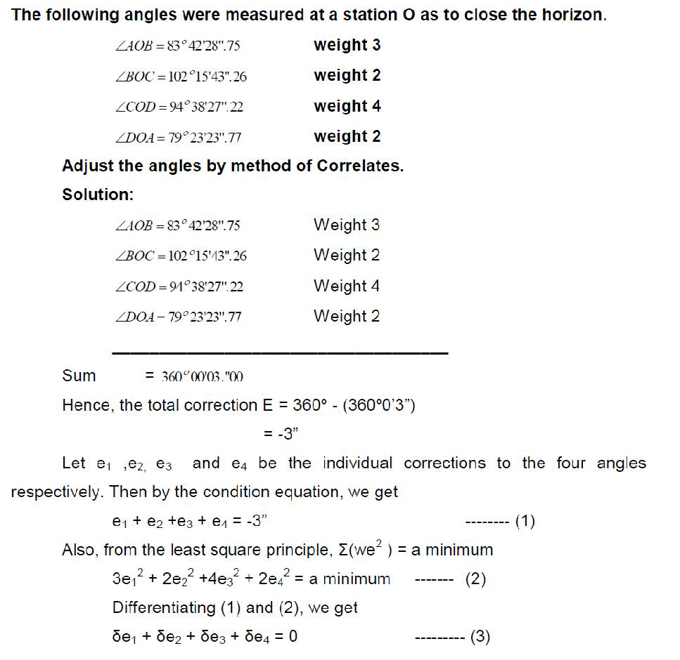
www.Vidyarthiplus.com
CE6404
SURVEYING II
SCE
18
Department of Civil Engineering
www.Vidyarthiplus.com

Slide 22
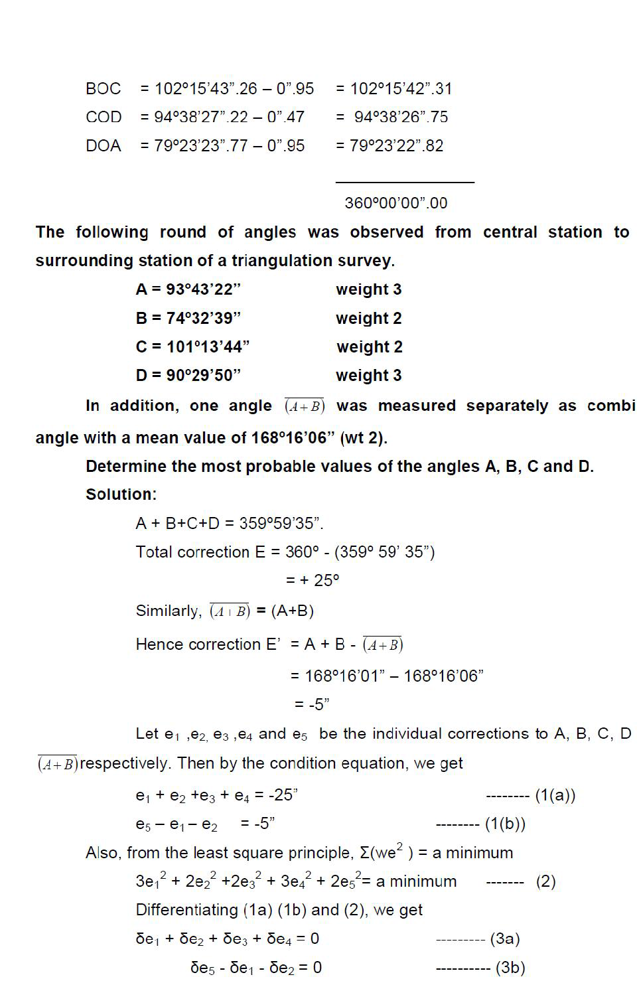
www.Vidyarthiplus.com
CE6404
SURVEYING II
S
www.Vidyarthiplus.com

Slide 23
www.Vidyarthiplus.com
CE6404
SURVEYING II
S
ering
www.Vidyarthiplus.com

Slide 24
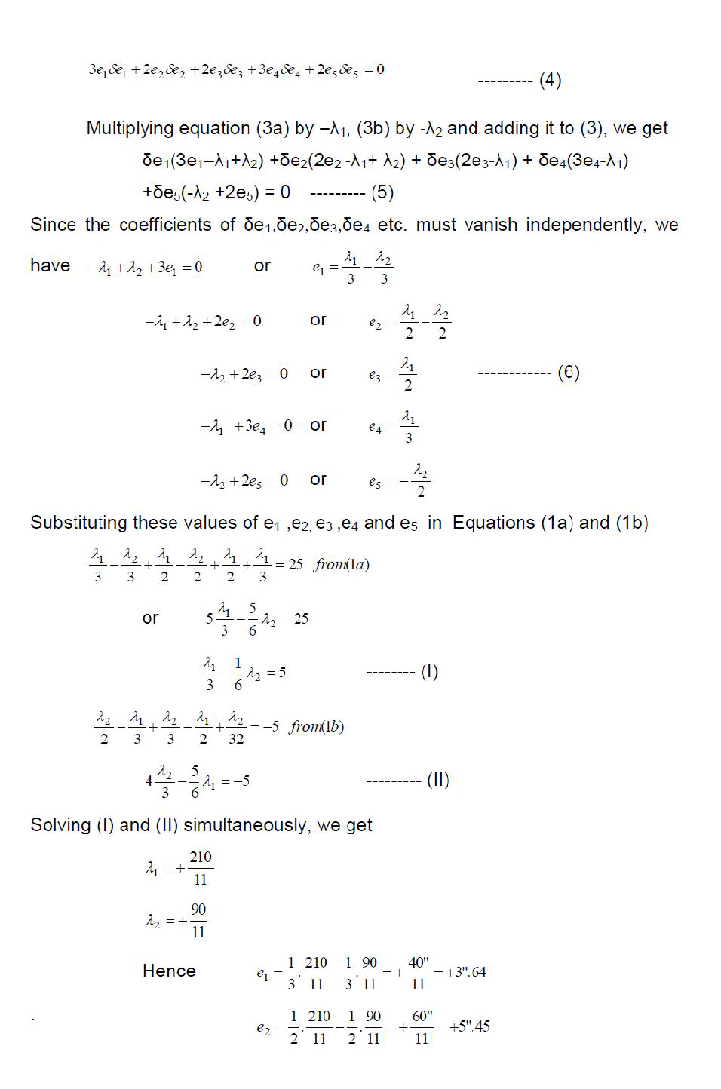
www.Vidyarthiplus.com
CE6404
SURVEYING II
S
g
www.Vidyarthiplus.com

Slide 25
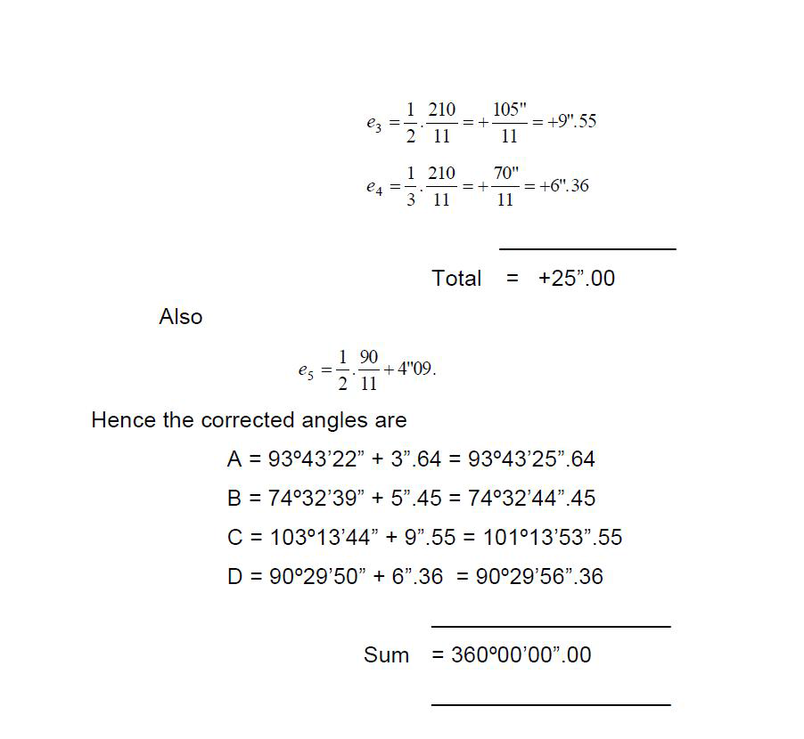
www.Vidyarthiplus.com
CE6404
SURVEYING II
SCE
22
Department of Civil Engineering
www.Vidyarthiplus.com

Slide 26
www.Vidyarthiplus.com
CE6404
SURVEYING II
CHAPTER 3
TOTAL STATION
Fig 3.1 Total Station
Because the instrument combines both angle and distance measurement in the same unit, it is known as an integrated total station which can measure horizontal and vertical angles as well as slope distances.
SCE
23
Department of Civil Engineering
www.Vidyarthiplus.com

Slide 27
www.Vidyarthiplus.com
CE6404
SURVEYING II
Using the vertical angle, the total station can calculate the horizontal and vertical distance components of the measured slope distance.
As well as basic functions, total stations are able to perform a number of different survey tasks and associated calculations and can store large amounts of data.
As with the electronic theodolite, all the functions of a total station are controlled by its microprocessor, which is accessed thought a keyboard and display.
To use the total station, it is set over one end of the line to be measured and some reflector is positioned at the other end such that the line of sight between the instrument and the reflector is unobstructed (as seen in the figure below).
-The reflector is a prism attached to a detail pole
-The telescope is aligned and pointed at the prism
-The measuring sequence is initiated and a signal is sent to the reflector and a part of this signal is returned to the total station
-This signal is then analysed to calculate the slope distance together with the horizontal and vertical angles.
-Total stations can also be used without reflectors and the telescope is pointed at the point that needs to be measured
-Some instruments have motorised drivers and can be use automatic target recognition to search and lock into a prism - this is a fully automated process and does not require an operator.
-Some total stations can be controlled from the detail pole, enabling surveys to be conducted by one person
SCE
24
Department of Civil Engineering
www.Vidyarthiplus.com

Slide 28
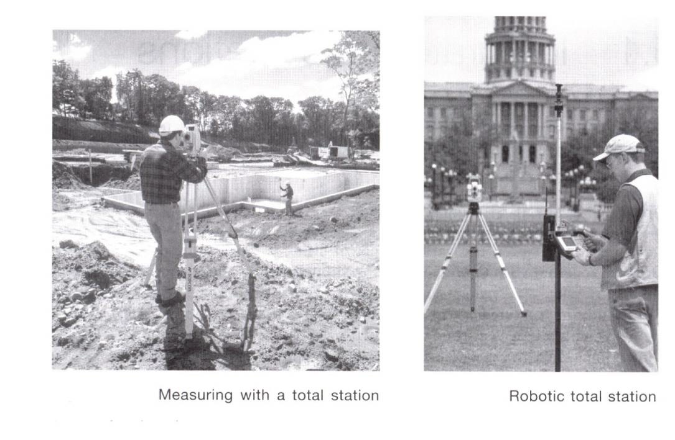
www.Vidyarthiplus.com
CE6404
SURVEYING II
Fig 3.2 Measuring with a Total Station
Most total stations have a distance measuring range of up to a few kilometres, when using a prism, and a range of at least 100m in reflector less mode and an accuracy of 2-3mm at short ranges, which will decrease to about 4-5mm at 1km.
Although angles and distances can be measured and used separately, the most common applications for total stations occur when these are combined to define position in control surveys.
As well as the total station, site surveying is increasingly being carried out using GPS equipment. Some predictions have been made that this trend will continue, and in the long run GPS methods may replace other methods.
Although the use of GPS is increasing, total stations are one of the predominant instruments used on site for surveying and will be for some time.
Developments in both technologies will find a point where devices can be made that complement both methods.
SCE
25
Department of Civil Engineering
www.Vidyarthiplus.com

Slide 29
www.Vidyarthiplus.com
CE6404
SURVEYING II
3.2 CLASSIFICATION OF TOTAL STATIONS
3.2.1 ELECTRO- OPTICAL SYSTEM
3.2.1.1 DISTANCE MEASUREMENT
When a distance is measured with a total station, am electromagnetic wave or pulse is used for the measurement - this is propagated through the atmosphere from the instrument to reflector or target and back during the measurement.
Distances are measured using two methods: the phase shift method, and the pulsed laser method.
This technique uses continuous electromagnetic waves for distance measurement although these are complex in nature, electromagnetic waves can be represented in their
simplest
from
as
periodic
waves.
Fig 3.3 Sinusoidal wave motion
The wave completes a cycle when moving between identical points on the wave and the number of times in one second the wave completes the cycle is called the frequency of the wave. The speed of the wave is then used to estimate the distance.
3.2.2 LASER DISTANCE MEASUREMENT
In many total stations, distances are obtained by measuring the time taken for a pulse of
laser radiation to travel from the instrument to a prism (or target) and back.
As in the
SCE
26
Department of Civil Engineering
www.Vidyarthiplus.com

Slide 30
www.Vidyarthiplus.com
CE6404
SURVEYING II
phase shift method, the pulses are derived an infrared or visible laser diode and they are transmitted through the telescope towards the remote end of the distance being measured, where they are reflected and returned to the instrument.
Since the velocity v of the pulses can be accurately determined, the distance D can be obtained using 2D = vt,where t is the time taken for a single pulse to travel from instrument - target - instrument.
This is also known as the timed-pulse or time-of-flight measurement technique.
The transit time t is measured using electronic signal processing techniques. Although only a single pulse is necessary to obtain a distance, the accuracy obtained would be poor.To improve this, a large number of pulses (typically
20,000 every second) are analysed during each measurement to give a more accurate distance.
The pulse laser method is a much simpler approach to distance measurement than the phase shift method, which was originally developed about 50 years ago.
SLOPE AND HORIZONTAL DISTANCES
Both the phase shift and pulsed laser methods will measure a slope distance L from the total station along the line of sight to a reflector or target.For most surveys the horizontal distance D is required as well as the vertical component V of the slope distance.
Horizontal distance D = L cosα = L sin z
Vertical distance = V = L sinα = L cos z
Where α is the vertical angle and z is the is the zenith angle. As far as the user is concerned, these calculations are seldom done because the total station will either display D and V automatically or will dislplay L first and then D and V after pressing buttons
SCE
27
Department of Civil Engineering
www.Vidyarthiplus.com

Slide 31
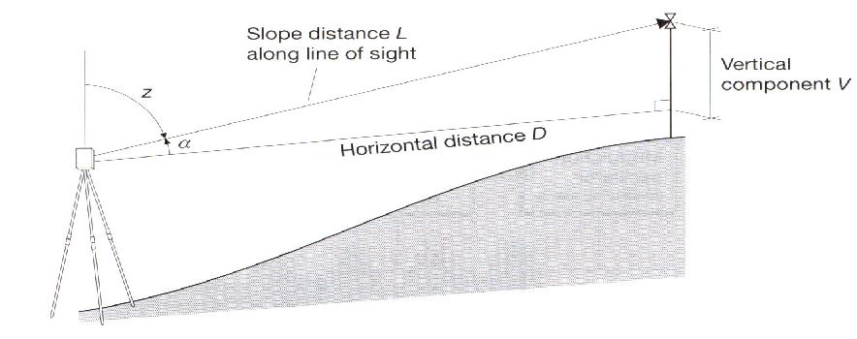
www.Vidyarthiplus.com
CE6404
SURVEYING II
Fig 3.4 Slope and Distance Measured
How accuracy of distance measurement is specified
All total stations have a linear accuracy quoted in the form ±(a mm + b ppm)
The constant a is independent of the length being measured and is made up of internal sources within the instrument that are normally beyond the control of the user.It is an estimate of the individual errors caused by such phenomena as unwanted phase shifts in electronic components, errors in phase and transit time measurements.
The systematic error b is proportional to the distance being measured, where 1 ppm (part per million) is equivalent to an additional error of 1mm for every kilometre measured.
Typical specifications for a total station vary from ±(2mm + 2ppm) to ±(5mm + 5 pmm). For example: ±(2mm + 2ppm), at 100m the error in distance measurement will be ±2mm but at 1.5km, the error will be ±(2mm + [2mm/km * 1.5km]) = ±5mm
Reflectors used in distance measurement
Since the waves or pulses transmitted by a total station are either visible or infrared, a plane
mirror could be used to reflect them. This would require a very accurate alignment of the mirror, because the transmitted wave or pulses have a narrow spread.
To get around this problem special mirror prisms are used as shown below.
SCE
28
Department of Civil Engineering
www.Vidyarthiplus.com

Slide 32
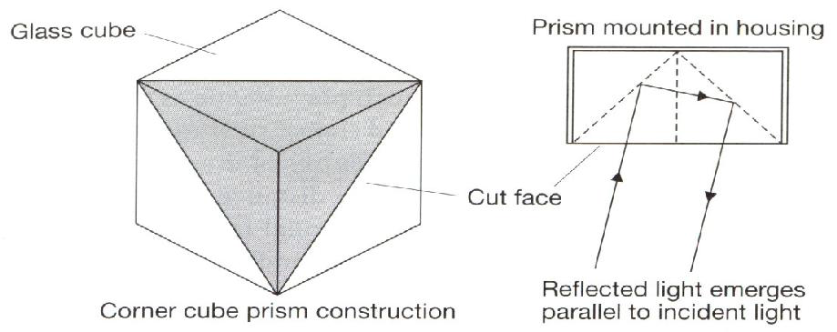
www.Vidyarthiplus.com
CE6404
SURVEYING II
Fig 3.5 Reflector used in total station
3.3 FEATURES OF TOTAL STATIONS
Total stations are capable of measuring angles and distances simultaneously and combine an electronic theodolite with a distance measuring system and a microprocessor.
ANGLE MEASUREMENT
All the components of the electronic theodolite described in the previous lectures are found total stations.
The axis configuration is identical and comprises the vertical axis, the tilting axis and line of sight (or collimation). The other components include the tribatch with levelling footscrews, the keyboard with display and the telescope which is mounted on the standards and which rotates around the tilting axis.
Levelling is carried out in the same way as for a theodolite by adjusting to centralise a plate
level or electronic bubble. The telescope can be transited and used in the face left (or face I) and face right (or face II) positions. Horizontal rotation of the total station about the vertical axis is controlled by a horizontal clamp and tangent screw and rotation of the telescope about the tilting axis.
The total station is used to measure angles in the same way as the electronic theodolite.
SCE
29
Department of Civil Engineering
www.Vidyarthiplus.com

Slide 33
www.Vidyarthiplus.com
CE6404
SURVEYING II
Distance measurement
All total stations will measure a slope distance which the onboard computer uses, together with the zenith angle recorded by the line of sight to calculate the horizontal distance.
For distances taken to a prism or reflecting foil, the most accurate is precise measurement.
For phase shift system, a typical specification for this is a measurement time of about 1- 2s, an accuracy of (2mm + 2ppm) and a range of
3-5km to a single prism.
Although all manufacturers quote ranges of several kilometres to a single prism.
For those construction projects where long distances are required to be measured, GPS methods are used in preference to total stations.There is no standard difference at which the change from one to the other occurs, as this will depend on a number of factors, including the accuracy required and the site topography.
Rapid measurement reduces the measurement time to a prism to between 0.5 and 1’s for both phase shift and pulsed systems, but the accuracy for both may degrade slightly.
Tracking measurements are taken extensively when setting out or for machine control, since readings are updated very quickly and vary in response to movements of the prism which is usually pole-mounted.In this mode, the distance measurement is repeated automatically at intervals of less than 0.5s.
For reflector less measurements taken with a phase shift system, the range that can be obtained is about 100m, with a similar accuracy to that obtained when using a prism or foil.
3.4 KEYBOARD AND DISPLAY
A total station is activated through its control panel, which consists of a keyboard and multiple lineLCD. A number of instruments have two control panels, one on each face, which makes them easier to use.
In addition to controlling the total station, the keyboard is often used to code data generated by the instrument - this code will be used to identify the object being measured.
On some total stations it is possible to detach the keyboard and interchange them with other total stations and with GPS receivers.This is called integrated surveying
SCE
30
Department of Civil Engineering
www.Vidyarthiplus.com

Slide 34
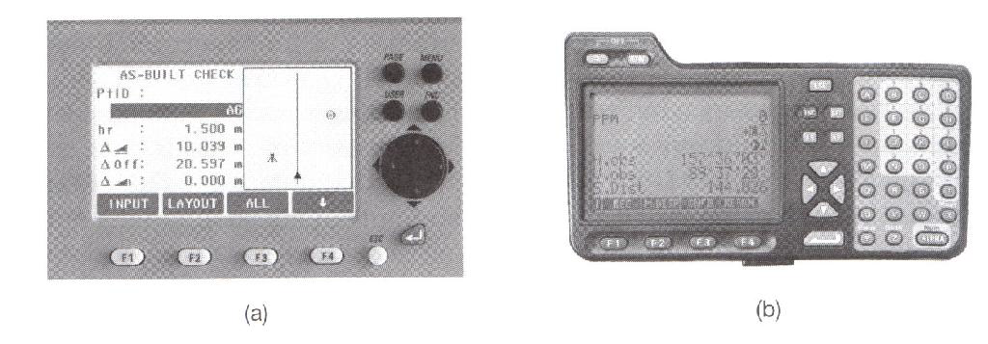
www.Vidyarthiplus.com
CE6404
SURVEYING II
Fig 3.6 Key Board and Display
3.5 SOFTWARE APPLICATIONS
The microprocessor built into the total station is a small computer and its main function is
controlling the measurement of angles and distances. The LCD screen guides the operator while taking these measurements.
The built in computer can be used for the operator to carry out calibration checks on the instrument.
The software applications available on many total stations include the following: Slope corrections and reduced levels
Horizontal circle orientation Coordinate measurement Traverse measurements Resection (or free stationing) Missing line measurement Remote elevation measurement areas
Setting out.
3.6 SOURCES OF ERROR FOR TOTAL STATIONS
3.6.1 CALIBRATION OF TOTAL STATIONS
SCE
31
Department of Civil Engineering
www.Vidyarthiplus.com

Slide 35
www.Vidyarthiplus.com
CE6404
SURVEYING II
To maintain the high level of accuracy offered by modern total stations, there is now much more emphasis on monitoring instrumental errors, and with this in mind, some construction sites require all instruments to be checked on a regular basis using procedures outlined in the quality manuals.
Some instrumental errors are eliminated by observing on two faces of the total station and averaging, but because one face measurements are the preferred method on site, it is important to determine the magnitude of instrumental errors and correct for them.
For total stations, instrumental errors are measured and corrected using electronic calibration procedures that are carried out at any time and can be applied to the instrument on site. These are preferred to the mechanical adjustments that used to be done in labs by technician.
Since calibration parameters can change because of mechanical shock, temperature changes and rough handling of what is a high-precision instrument, an electronic calibration should be carried our on a total station as follows:
Before using the instrument for the first time After long storage periods
After rough or long transportation After long periods of work
Following big changes in temperature Regularly for precision surveys
Before each calibration, it is essential to allow the total station enough to reach the ambient temperature.
3.6.2 HORIZONTAL COLLIMATION (OR LINE OF SIGHT ERROR)
This axial error is caused when the line of sight is not perpendicular to the tilting axis. It
affects all horizontal circle readings and increases with steep sightings, but this is eliminated by
observing on two faces.
For single face measurements,
an on-board calibration function is used to determine c, the deviation between the actual line of sight and a line perpendicular to the tilting axis.A correction is then applied automatically for this to all horizontal circle readings.
SCE
32
Department of Civil Engineering
www.Vidyarthiplus.com

Slide 36
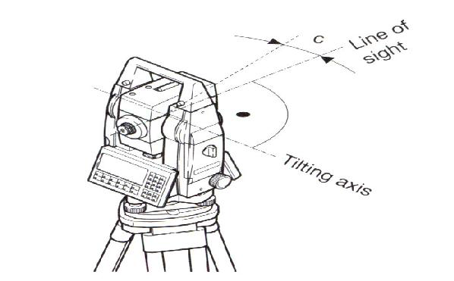
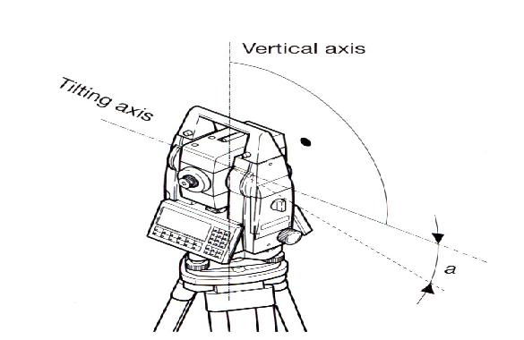
www.Vidyarthiplus.com
CE6404
SURVEYING II
Fig 3.7 Line of Sight error
3.6.3 TILTING AXIS ERROR
This axial errors occur when the titling axis of the total station is not perpendicular to its vertical axis. This has no effect on sightings taken when the telescope is horizontal, but introduces errors into horizontal circle readings when the
telescope is tilted, especially for steep sightings. As with horizontal collimation error, this error is eliminated by two face measurements, or the tilting axis error a is measured in a calibration procedure and a correction applied for this to all horizontal circle readings - as before if a is too big, the instrument should be returned to the manufacture.
Fig tilting axis error
3.6.4 COMPENSATOR INDEX ERROR
SCE
33
Department of Civil Engineering
www.Vidyarthiplus.com

Slide 37
www.Vidyarthiplus.com
Errors caused by not levellinga theodolite or total station carefully cannot be eliminated by taking face left and face right readings. If the total station is fitted with a compensator it will measure residual tilts of the instrument and will apply corrections to the horizontal and vertical angles for these.
However all compensators will have a longitudinal error l and traverse error t known as zero point errors. These are averaged using face left and face right readings but for single face readings must be determined by the calibration function of the total station.
Fig 3.8 Compensator Index Error
A vertical collimation error exists on a total station if the 0o to 180o line in the vertical circle does not coincide with its vertical axis. This zero point error is present in all vertical circle readings and like the horizontal collimation error, it is eliminated by taking FL and FR readings or by determining i
For all of the above total station errors (horizontal and vertical collimation, tilting axis and compensator) the total station is calibrated using an in built function. Here the function is activated and a measurement to a target is taken as shown below.
SCE
35
Department of Civil Engineering
www.Vidyarthiplus.com

Slide 38
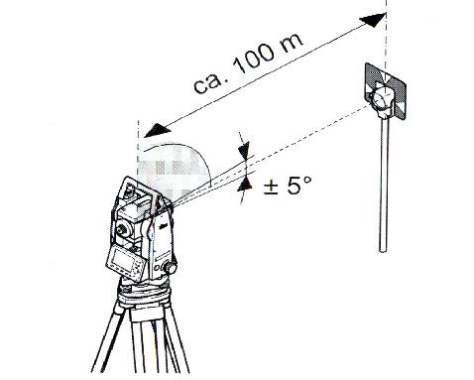
www.Vidyarthiplus.com
Following the first measurement the total station and the telescope are each rotated through 180o and the reading is repeated.
Any difference between the measured horizontal and vertical angles is then quantified as an instrumental error and applied to all subsequent readings automatically. The total station is thus calibrated and the procedure is the same for all of the above error type.
Fig 3.9 Compensator Index Error
SCE
36
Department of Civil Engineering
www.Vidyarthiplus.com

Slide 39
www.Vidyarthiplus.com
CHAPTER 4
GPS SURVEYING
4.1 INTRODUCTION
Traditional methods of surveying and navigation resort to tedious field and astronomical observation for deriving positional and directional information. Diverse field conditions, seasonal variationand many unavoidable circumstances always bias the traditional field approach. However, due to rapid advancement in electronic systems, every aspect of human life is affectedto a great deal. Field of surveying and navigation is tremendously benefited through electronic devices. Many of the critical situations in surveying/navigation are now easily and precisely solved in short time.
Astronomical observation of celestial bodies was one of the standard methods of obtaining coordinates of a position. This method is prone to visibility and weather condition and demands expert handling. Attempts have been made by USA since early 1960’s to use space based artificial satellites. System TRANSIT was widely used for establishing a network of control points over large regions. Establishment of modern geocentric datum and its relation to local datum was successfully achieved through TRANSI T. Rapid improvements in higher frequently transmission and precise clock signals along with advanced stable satellite technology have been instrumental for the development of global positioning system.
SCE
37
Department of Civil Engineering
www.Vidyarthiplus.com

Slide 40
www.Vidyarthiplus.com
have been now modeled to a great extent from past experience to obtain precise information for various applications.
Comparison of main characteristics of TRANSIT and GPS re veal technological advancement in the field of space based positioning system (Table1).
Table 1. TRANSIT vs GPS
Details
TRANSIT
GPS
Orbit Altitude
1000 Km
20,200 Km
Orbital Period
105 Min
12 Hours
Frequencies
150 MHz
1575 MHz
Navigation data
400 MHz
1228 MHz
2D : X , Y
4D : X,Y,Z, t velocity
Availability
15-20 minute per pass
Continuously
Accuracy
ñ 30-40 meters
ñ15m (Pcode/No. SA
Repeatability
(Depending on velocity
0.1 Knots
—
ñ1.3 meters relative
Satellite
4-6
21-24
Geometry
Variable
Repeating
Satellite Clock
Quartz
Rubidium, Cesium
GPS has been designed to provide navigational accuracy of ±10 m to ±15 m. However, sub meter accuracy in differential mode has been achieved and it has been proved that broad varieties of problems in geodesy and geodynamics can be tackled through GPS.
Versatile use of GPS for a civilian need in following fields have been successfully practiced viz. navigation on land, sea, air, space, high precision kinematics survey on the ground, cadastral surveying, geodetic control network densification, high precision aircraft positioning, photogrammetry without ground control, monitoring deformations, hydrographic surveys, active control survey and many other similar jobs related to navigation and positioning,. The outcome of a typical GPS survey includes geocentric position accurate to 10 m and relative positions between receiver locations to centimeter level or better.
4.2 SEGMENTS OF GPS
For better understanding of GPS, we normally consider three major segments viz. space segment, Control segment and User segment. Space segment deals with GPS
SCE
40
Department of Civil Engineering
www.Vidyarthiplus.com

Slide 41
www.Vidyarthiplus.com
frequency with Pseudorandom Noise (PRN) codes. These are sequence of binary values (zeros and ones or +1 and -1) having random character but identifiable distinctly. Thus pseudoranges are derived from travel time of an identified PRN signal code. Two different codes viz. P-code and C/A code are in use. P means precision or protected and C/A means clear/acquisition or coarse acquisition.
P- code has a frequency of 10.23 MHz. This refers to a sequence of 10.23 million binary digits or chips per second. This frequency is also referred to as the chipping rate of P- code. Wavelength corresponding to one chip is29.30m. The P-code sequence is extremely long and repeats only after 266days. Portions of seven days each are assigned to the various satellites. As a consequence, all satellite can transmit on the same frequency and can be identified by their unique one-week segment. This technique is also called as Code Division Multiple Access(CDMA). P-code is the primary code for navigation and is available on carrier frequencies L1 and L2.
The C/A code has a length of only one millisecond; its chipping rate is 1.023 MHz with corresponding wavelength of300 meters. C/A code is only transmitted on L1 carrier.
GPS receiver normally has a copy of the code sequence for determining the signal propagation time. This code sequence is phase-shifted in time step- by-step and correlated with the received code signal until maximum correlation is achieved. The necessary phase-shift in the two sequences of codes is a measure of the signal travel time between the satellite and the receiver antennas. This technique can be explained as code phase observation.
For precise geodetic applications, the pseudoranges should be derived from phase measurements on the carrier signals because of much higher resolution. Problems of ambiguity determination are vital for such observations.
The third type of signal transmitted from a GPS satellite is the broadcast message sent at a rather slow rate of 50 bits per second (50 bps) and repeated every 30 seconds. Chip sequence of P-code and C/A code are separately combined with the stream of message bit by binary addition ie the same value for code and message chip gives 0 and different values result in 1.
The main features of all three signal types used in GPS observation viz carrier, code and data signals are given in Table 3.
GPS Satellite Signals
Atomic Clock
(G, Rb) fundamental
10.23. MHz
L1
Carrier Signal
154 X 10.23 MHz
L1
Frequency
1575.42 MHz
L1
Wave length
19.05 Cm
L2
Carrier Signal
120 X 10.23 MHz
SCE
44
Department of Civil Engineering
www.Vidyarthiplus.com

Slide 42
www.Vidyarthiplus.com
the control segment.
- Monitoring and controlling the satellite system continuously
- Determine GPS system time
- Predict the satellite ephemeris and the behavior of each satellite clock.
- Update periodically the navigation message for each particular satellite.
For continuos monitoring and controlling GPS satellites a master control stations(MCS), several monitor stations(MS) and ground antennas (GA) are located around the world (Fig. 9). The operational control segment (OCS) consists of MCS near Colorado springs (USA), three MS and GA in Kwajaleian Ascension and Diego Garcia and two more MS at Colorado Spring and Hawai.
4.7 GROUND CONTROL SEGMENT
The monitor station receives all visible satellite signals and determines their pseudoragesandthentransmits the range data along with the localmeteorological data via data link to the master control stations. MCS then precomputes satellite ephemeris and the behaviour of the satellite clocks and formulates the navigation data. The navigation message data are transmitted to the ground antennas and via S-band it links to the satellites in view. Fig. 9 shows this process schematically. Due to systematic global distribution of upload antennas, it is possible to have atleast three contacts per day between the control segment and each satellite.
4.8 USER SEGMENT
Appropriate GPS receivers are required to receive signal from GPS satellites for the purpose of navigation or positioning. Since, GPS is still in its development phase, many rapid advancements have completely eliminated bulky first generation user equipments and now miniature powerful models are frequently appearing in the market.
4.9 BASIC CONCEPT OF GPS RECEIVER AND ITS COMPONENTS
The main components of a GPS receiver are shown in Fig. 10. These are:
- Antenna with pre-amplifier
- RF section with signal identification and signal processing
- Micro-processor for receiver control, data sampling and data processing
- Precision oscillator
SCE
48
Department of Civil Engineering
www.Vidyarthiplus.com

Slide 43
www.Vidyarthiplus.com
In the sequencing channel concept the channel sw itches from satellite to satellite at regular interval. A single channel receiver takes atleast four times of 30 seconds to establish first position fix, though some receiver types have a dedicated channel for reading the data signal. Now days in most of the cases fast sequencing channels with a switching rate of about one-second per satellite are used.
In multiplexing channel, sequencing at a very high speed between different satellites is achieved using one or both frequencies. The switching rate is synchronous with the navigation message of 50bps or 20 milliseconds per bit. A complete sequence with four satellites is completed by 20 millisecond or after 40 millisecond for dual frequency receivers. The navigation message is continuous, hence first fix is achieved after about 30 seconds.
Though continuous tracking parallel channels are cheap and give good overall performance, GPS receivers based on multiplexing technology will soon be available at a cheaper price due to electronic boom.
Microprocessor
` To control the operation of a GPS receiver, a microprocessor is essential for acquiring the signals, processing of the signal and the decoding of the broadcast message. Additional capabilities of computation of on-line position and velocity, conversion into a given local datum or the determination of waypoint information are also required. In future more and more user relevant software will be resident on miniaturized memory chips.
Precision Oscillator
A reference frequency in the receiver is generated by the precision oscillator. Normally, less expensive, low performance quartz oscillator is used in receivers since the precise clock information is obtained from the GPS satellites and the user clock error can be eliminated through double differencing technique when all participating receivers observe at exactly the same epoch. For navigation with two or three satellites only an external high precision oscillator is used.
SCE
51
Department of Civil Engineering
www.Vidyarthiplus.com

Slide 44
www.Vidyarthiplus.com
Power Supply
First generation GPS receivers consumed very high power, but modern receivers are designed to consume as little energy as possible. Most receivers have an internal rechargeable. Nickel-Cadmium battery in addition to an external power input. Caution of low battery signal prompts the user to ensure adequate arrangement of power supply.
Memory Capacity
For port processing purposes all data have to be stored on internal or external memory devices. Post processing is essential for multi station techniques applicable to geodatic and surveying problems. GPS observation forpseudoranges, phase data, time and navigation message data have to be recorded. Based on sampling rate, it amount to about 1.5 Mbytes of data per hour for six satellites and 1 second data for dual frequency receivers. Modern receivers have internal memories of5 Mbytes or more. Some receivers store the data on magnetic tape or on a floppy disk or hard-disk using external microcomputer connected through RS-232 port.
Most modern receivers have a keypad and a display for communication between the user and the receivers. The keypad is used to enter commands, external data like station number or antenna height or to select a menu operation. The display indicates computed coordinates, visible satellites, data quality indices and other suitable information. Current operation software packages are menu driven and very user friendly.
4.10 CLASSIFICATION OF GPS RECEIVERS
GPS receivers can be divided into various groups according to different criteria. In the early stages two basic technologies were used as the classification criteria viz. Code correlation receiver technology and sequencing receiver technology, which were equivalent to code dependent receivers and code free receivers. However, this kind of division is no longer justifiable since both techniques are implemented in present receivers.
Another classification of GPS receivers is basedon acquisition of data types e.g.
SCE
52
Department of Civil Engineering
www.Vidyarthiplus.com

Slide 45
www.Vidyarthiplus.com
- C/A code receiver
- C/A code + L1 Carrier phase
- C/A code + L1 Carrier phase + L2 Carrier phase
- C/A code + p_code + L1, L2 Carrier phase
- L1 Carrier phase (not very common)
- L1, L2 Carrier phase (rarely used)
Based on technical realization of channel, the GPS receivers can be classified as:
-
Multi-channel receiver
-
Sequential receiver
-
Multiplexing receiver
GPS receivers are even classified on the purpose as:
- Military receiver
- Civilian receiver
- Navigation receiver
- Timing receiver
- Geodetic receiver
For geodetic application it is essential to use the carrier phase data as observable. Use of L1 and L2 frequency is also essential along with P-code.
Examples of GPS Receiver
GPS receiver market is developing and expanding at a very high speed. Receivers are becoming powerful, cheap and smaller in size. It is not possible to give details of every make but description of some typical receivers given may be regarded as a basis for the evaluation of future search and study of GPS receivers.
Classical Receivers
Detailed description of code dependent T1 4100 GPS Navigator and code free Macrometer V1000 is given here:
SCE
53
Department of Civil Engineering
www.Vidyarthiplus.com

Slide 46
www.Vidyarthiplus.com
T1 4100 GPS Navigator was manufactured by Texas Instrument in 1984. It was the first GPS receiver to provide C/A and P code and L1 and L2 carrier phase observations. It is a dual frequency multiplexing receiver and suitable for geodesist, surveyor and navigators. The observables through it are:
- P-Code pseudo ranges on L1 and L2
- C/A-Code pseudo ranges on L1
- Carrier phase on L1 and L2
The data are recorded by an external tape recorder on digital cassettes or are downloaded directly to an external microprocessor. A hand held control display unit (CDU) is used for communication between observer and the receiver. For navigational purposes the built in microprocessor provides position and velocity in real time every three seconds. T1 4100is a bulky instrument weighing about33kg and can be packed in two transportation cases. It consumes 90watts energy in operating mode of 22V - 32V. Generator use is recommended. The observation noise in P-Code is between 0.6 to 1 m, in C/ A code it ranges between 6 to 10 m and for carrier phase it is between 2 to 3 m.
T1 4100 has been widely used in numerous scientific and
applied GPS projects and is still in use. The main disadvantages of the T1 4100 compared to more modern GPS equipment’s are
- Bulky size of the equipment
- High power consumption
- Difficult operation procedure
- Limitation of tracking four satellites simultaneously
- High noise level in phase measurements
Sensitivity of its antenna for multipath and phase centre variation if two receivers are connected to one antenna and tracking of seven satellites simultaneously is possible. For long distances and in scientific projects, T1 4100 is still regarded useful. However, due to imposition of restriction on P- code for civilian, T1 4100 during Anti Spoofing (AS) activation can only be used as a single frequency C/A code receiver.
The MACROMETER V 1000, a code free GPS receiver was introduced in 1982 and was the first receiver for geodetic applications. Precise results obtained through it has demonstrated the potential of highly accurate GPS phase observations. It is a single frequencyreceiver and tracks 6 satellites on
SCE
54
Department of Civil Engineering
www.Vidyarthiplus.com

Slide 47
www.Vidyarthiplus.com
6 parallel channels. The complete system consists of three units viz.
- Receiver and recorder with power supply
- Antenna with large ground plane
- P 1000 processor
The processor is essential for providing the almanac data because the Macrometer V 1000 cannot decode the satellite messages and process the data. At pre determined epoches the phase differences between the received carrier signal and a reference signal from receiver oscillator is measured. A typical baseline accuracy reported for upto 100 km distance is about 1 to 2 ppm (Parts per million).
Macrometer II, a dual frequency version was introduced in 1985. Though it is comparable to Macrometer V 1000, its power consumption and weight are much less. Both systems require external ephemeredes. Hence specialized operators of few companies are capable of using it and it is required to synchronize the clock of all the instruments proposed to be used for a particular observation session. To overcome above disadvantages, the dual frequency Macrometer II was further miniaturized and combined with a single frequency C/A code receiver with a brand name MINIMAC in 1986, thus becoming a code dependent receiver.
Examples of present Geodetic GPS Receivers
Few of the currently available GPS receivers that are used in geodesy surveying and precise navigation are described. Nearly all models started as single frequency C/A-Code receivers with four channels. Later L2 carrier phase was added and tracking capability was increased. Now a days all leading manufacturers have gone for code-less, non-sequencing L2 technique. WILD/ LEITZ (Heerbrugg, Switzerland) and MAGNAVOX (Torrance, California) have jointly developed WM 101 geodetic receiver in 1986. It is a four channel L1 C/A code receiver. Three of the channels sequentially track upto six satellites and the fourth channel, a house keeping channels, collects the satellite message and periodically calibrates the inter channel biases. C/A-code and reconstructed L1 carrier phase data are observed once per second.
The dual frequencyWM 102 was marketed in 1988 with following key features:
- L1 reception with seven C/A code channel tracking upto six satellites simultaneously.
- L2 reception of up to six satellites with one sequencing P- code channel
- Modified sequencing technique for receiving L2 when P-code signals are encrypted.
SCE
55
Department of Civil Engineering
www.Vidyarthiplus.com

Slide 48
www.Vidyarthiplus.com
The observations can be recorded on built in data cassettes or can be transferred on line to an external data logger in RS232or RS422interface. Communication between operator and receiver is established by alpha numerical control panel and display WM 101/102 has a large variety of receiver resident menu driven options and it is accompanied by comprehensive post processing software.
In 1991, WILD GPS system 200 was introduced. Its hardware comprises the Magnavox SR 299 dual frequency GPS sensor, the hand held CR 233 GPS controller and a Nicd battery. Plug in memory cards provide the recording medium. It can track 9 satellites simultaneously on L1 and L2. Reconstruction of carrier phase on L1 is through C/A code and on L2 through P-code. The receiver automatically switches to codeless L2 when P-code is encrypted. It consumes 8.5 watt through 12-volt power supply.
TRIMBLE NAVIGATION (Sunny vale, California) has been producing TRIMBLE 4000 series since 1985. The first generation receiver was a L1 C/ A code receiver with five parallel channels providing tracking of5satellites simultaneously. Further upgradation included increasing the number of channels upto tweleve, L2 sequencing capability and P-code capability. TRIMBLE Geodatic Surveyor4000 SSE is the most advanced model. When P-Code is available, it can perform following types of observations, viz.,
- Full cycle L1 and L2 phase measurements
- L1 and L2, P-Code measurements when AS is on and P- code is encrypted
- Full cycle L1 and L2 phase measurement
- Low noise L1, C/A code
- Cross-correlated Y-Code data
Observation noise of the carrier phase measurement when P-code is available is about ñ 0-2mm and of the P-code pseudoranges as low as ñ 2cm. Therefore, it is very suitable for fast ambiguity solution techniques with code/ carrier combinations.
ASHTECH (Sunnyvale, California) developed a GPS receiver with 12 parallel channels and pioneered current multi-channel technology. ASHTECH XII GPS receiver was introduced in1988. It is capable of measuring pseudoranges, carrier phase and integrated dopler of up to 12 satellites on L1. The pseudoranges measurement are smoothed with integrated Doppler. Postion velociy, time and navigation informations are displayed on a keyboard with a 40-characters display. L2 option adds 12 physical L2 squaring type channels.
ASHTECH XII GPS receiver is a most advanced system, easy to handle and does not require initialization procedures. Measurements of all satellites in view are carried out
SCE
56
Department of Civil Engineering
www.Vidyarthiplus.com

Slide 49
www.Vidyarthiplus.com
automatically. Data can be stored in the internal solid plate memory of 5 Mbytes capacity. The minimum sampling interval is 0.5 seconds. Like many other receivers it has following additional options viz.
- 1 ppm timing signal output
- Photogrammetric camera input
- Way point navigation
- Real time differential navigation and provision of port processing and vision planning software
In 1991, ASHTECH P-12 GPS receiver was marketed. It has 12 dedicated channels of L1, P-code and carrier and 12 dedicated channels of L2, P-code and carrier. It also has
12 L1, C/A code and carrier channels and 12 code less squaring L2 channels. Thus the receiver contains 48 channels and provides all possibilities of observations to all visible satellites. The signal to noise level for phase measurement on L2 is only slightly less than on L1 and significantly better than with code-less techniques. In cases of activated P- code encryption, the code less L2 option can be used.
TURBO ROGUE SNR-8000 is a portable receiver weighing around 4 kg, consumes 15-watt energy and is suitable for field use. It has 8 parallel channels on L1 and L2. It provides code and phase data on both frequencies
SCE
57
Department of Civil Engineering
www.Vidyarthiplus.com

Slide 50
www.Vidyarthiplus.com
and has a codeless option. Full P-code tracking provides highest precision phase and pseudo rages measurements, codeless tracking is automatic“full back” mode. The code less mode uses the fact that each carrier has identical modulation of P-code/Y- code and hence the L1 signal can be cross-correlated with the L2 signal. Results are the differentialphase measurement (L1-L2) and the group delay measurement (P1-P2)
Accuracy specifications are :
P-Code pseudo range
1cm (5 minutes integration) Codeless pseudo
range
10cm (5 minutes integration) Carrier phase
0.2 - 0.3 mm
Codelessphase
0.2 - 0.7 mm
One of the important features is that less than 1 cycle slip is expected for 100 satellitehours.
Navigation Receivers
Navigation receivers are rapidly picking up the market. In most cases a single C/A code sequencing or multiplexing channel is used. However, modules with four or five parallel channels are becoming increasingly popular. Position and velocity are derived from C/A code pseudoranges measurement and are displayed or downloaded to a personal computer. Usually neither raw data nor carrier phase information is available. Differential navigation is possible with some advanced models.
MAGELLAN NAV 1000 is a handheld GPS receiver and weighs only 850 grams. It was introduced in1989 and later in 1990, NAV 1000 PRO model was launched. It is a single channel receiver and tracks 3 to 4 satellites with a
2.5 seconds update rate and has a RS 232 data port.
The follow up model in 1991 was NAV 5000 PRO. It is a 5-channel receiver tracking all visible satellites with a1-second update rate. Differential navigation is possible. Carrier phase data can be used with an optional carrier phase module. The quadrifilar antenna is integrated to the receiver. Post processing of data is also possible using surveying receiver like ASHTECH XII located at a reference station. Relative accuracy is about 3 to 5 metres. This is in many cases sufficient for thematic purposes.
SCE
58
Department of Civil Engineering
www.Vidyarthiplus.com

Slide 51
www.Vidyarthiplus.com
Many hand held navigation receivers are available with added features. The latest market situation can be obtained through journals like GPS world etc.
For most navigation purpose a single frequency C/A code receiver is sufficient. For accuracy requirements better than 50 to 100 meters, a differential option is essential. For requirement below 5 meters, the inclusion of carrier phase data is necessary. In high precision navigation the use of a pair of receivers with full geodetic capability is advisable. The main characteristics of multipurpose geodetic receiver are summarized in
Table
4.
Table 4. Overview of geodetic dual-frequency GPS satellite receiver (1992)
Receiver
Channel
Code
Wavelen
Anti-
L1
L2
L1
L2
L1
L2
spoofing
TI 4100
4
4
P
P
/2
Single
MACROMET
6
6
-
-
/2
No influence
ASHTECH
12
12
C/A
-
No influence
ASHTECH P
12
12
C/A,
P
/2
Squaring
TRIMBLE
8-12
8-12
C/A
-
No influence
TRIMBLE
9-12
9-12
C/A,
P
Codeless SSE
WM 102
7
1
C/A
P
Squaring
WILD GPS
9
9
C/A
p
Codeless
TURBO
8
8
C/A,
P
Codeless
Some of the important features for selecting a geodetic receiver are :
- Tracking of all satellites
- Both frequencies
- Full wavelength on L2
- Low phase noise-low code noise
- High sampling rate for L1 and L2
- High memory capacity
SCE
59
Department of Civil Engineering
www.Vidyarthiplus.com

Slide 52
www.Vidyarthiplus.com
- Low power consumption
- Full operational capabilityunder anti spoofing condition
Further, it is recommended to use dual frequency receiver to minimize ion- spherical influences and take advantages in ambiguity solution.
4.11 ACCURACY
In general, an SPS receiver can provide position information with an error of less than 25 meter and velocity information with an error less than 5 meters per second. Upto2 May 2000 U.S Government has activated Selective Availability(SA) to maintain optimum militar y effectiveness. Selective Availability inserts random errors into the ephemeris information broadcast by the satellites, which reduces the SPS accuracy to around 100 meters.
For many applications, 100-meter accuracy is more than acceptable. For applications that require much greater accuracy, the effects of SA and environmentally produced errors can be overcome by using a technique called Differential GPS (DGPS), which increases overall accuracy.
4.12 DIFFERENTIAL THEORY
Differential positioning is technique that allows overcoming the effects of environmental errors and SA on the GPS signals to produce a highly accurate position fix. This is done by determining the amount of the positioning error and applying it to position fixes that were computed from collected data.
Typically, the horizontal accurac y of a single position fix from a GPS receiver is 15 meter RMS (root-mean Square) or better. If the distribution of fixes about the true position is circular normal with zero mean, an accuracy of 15 meters RMS implies that about 63% of the fixes obtained during a session are within 15 meters of the true position.
TYPES OF ERRORS
There are two types of positioning errors: correctable and non-correctable. Correctable errors are the errors that are essentially the same for two GPS receivers in the same area. Non-correctable errors cannot be correlated between two GPS receivers in the same area.
SCE
60
Department of Civil Engineering
www.Vidyarthiplus.com

Slide 53
www.Vidyarthiplus.com
4.13 CORRECTABLE ERRORS
Sources of correctable errors include satellite clock, ephemeris data and ionosphere and tropospheric delay. If implemented, SA may also cause a correctable positioning error. Clock errors and ephemeris errors originate with the GPS satellite. A clock error is a slowly changing error that appears as a bias on the pseudorange measurement made by a receiver. An ephemeris error is a residual error in the data used by a receiver to locate a satellite in space.
Ionosphere delay errors and tropospheric delay errors are caused by atmospheric conditions. Ionospheric delay is caused by the density of electrons in the ionosphere along the signal path. A tropspheric delay is related to humidity, temperature, and altitude along the signal path. Usually, a tropospheric error is smaller than an ionospheric error.
Another correctable error is caused by SA which is used by U.SDepartment of Defence to introduce errors into Standard Positioning Service (SPS) GPS signals to degradefix accuracy.
The amount of error and direction of the error at any given time does not change rapidly. Therefore, two GPS receivers that are sufficiently close together will observe the same fix error, and the size of the fix error can be determined.
NON-CORRECTABLE ERRORS
Non-correctable errors cannot be correlated between two GPS receivers that are located in the same general area. Sources of non-correctable errors include receiver noise, which is unavoidably inherent in any receiver, and multipath errors, which are environmental. Multi-path errors are caused by the receiver “seeing” reflections of signals that have bounced off of surrounding objects. The sub-meter antenna is multipath- resistant; its use is required when logging carrier phase data. Neither error can be eliminated with differential, but they can be reduced substantially with position fix averaging. The error sources and the approximateRMS error range are givenin the Table.
Error Sources
Error Source Approx. Equivalent Range
Error (RMS) in meters
Correctable with Differential
Clock (Space Segment)
3.0
Ephemeris (Control Segment)
2.7
Ionospheric Delay (Atmosphere)
8.2
Tropospheric Delay (Atmosphere)
1.8
Selective Availability (if implemented)
27.4
Total
28.9
SCE
61
Department of Civil Engineering
www.Vidyarthiplus.com

Slide 54
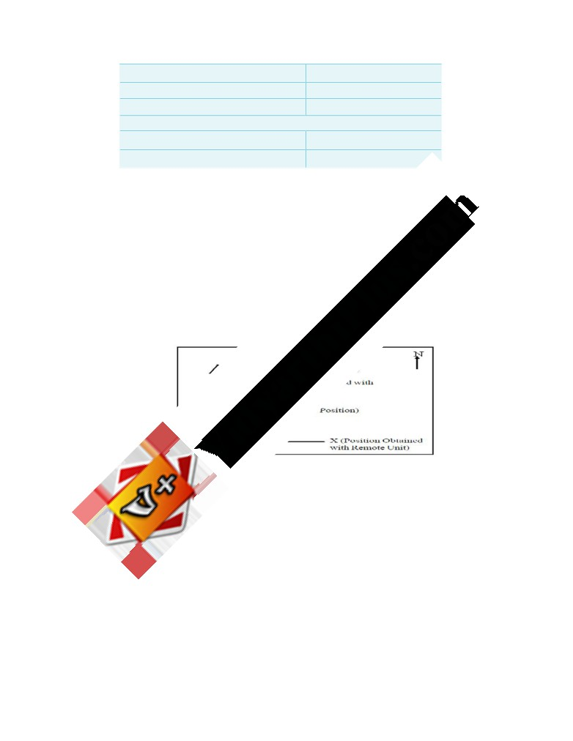
www.Vidyarthiplus.com
Non-Correctable with Differential
Receiver Noise (Unit)
9.1
Multipath (Environmental)
3.0
Total
9.6
Total user Equivalent range error (all sources)
30.5
Navigational Accuracy (HDOP = 1.5)
45.8
4.13 DIFFERENTIAL GPS
Most DGPS techniques use a GPS receiver at a geodetic control site whose position is known. The receiver collects positioning information and calculates a position fix, which is then compared to the known co-ordinates. The difference between the known position and the acquired position of the control location is the positioning error.
Because the other GPS receivers in the area are assumed to be operating under similar conditions, it is assumed that the position fixes acquired by other receivers in the area (remote units) are subject to the same error, and that the correction computed for the control position should therefore be accurate for those receivers. The correction is communicated to the remote units by an operator at the control site with radio or cellular equipment. In post-processed differential, all units collect data for off-site processing; no corrections are determined in the field. The process of correcting the position error with differential mode is shown in the Figure .
The difference between the known position and acquired position at the control point is the DELTA correction. DELTA, which is always expressed in meters, is parallel to the surface of the earth. When expressed in local co- ordinate system, DELTA uses North-South axis (y) and an East-West axis (x) in 2D operation; an additional vertical axis (z) that is perpendicular to the y and x is used in3D operation for altitude.
4.14 APPLICATIONS OF GPS
z Providing Geodetic control.
z Survey control for Photogrammetriccontrol surveys and mapping. z Finding out location of offshore drilling.
z Pipeline and Power line survey.
SCE
62
Department of Civil Engineering
www.Vidyarthiplus.com

Slide 55
www.Vidyarthiplus.com
z Navigation of civilian ships and planes. z Crustal movement studies.
z Geophysical positioning, mineral exploration and mining. z Determination of a precise geoid using GPS data. z Estimating gravityanomalies using GPS.
z Offshore positioning: shiping, offshore platforms, fishing boats etc.
CHAPTER 5
5.1 INTRODUCTION
ADVANCED TOPICS IN SURVEYING
Photogrammetry
- Introduction
- Terrestial and aerial Photographs
- Stereoscopy
- Parallax
- Electromagnetic distance measurement
- Carrier waves
- Trilateration
- Principles - Instruments
Hydrographic Surveying
- Tides
- MSL
- Sounding methods
- Location of soundings and methods
- Three point problem
- Strength of fix
- Sextants and station pointer
- River surveys
Cartography
- Measurement of current and discharge
- Cartographic concepts and techniques
- Cadastral surveying
- Definition
- Uses
- Legal values
- Scales and accuracies.
5.2 PHOTOGRAMMETRIC SURVEYING?
Photogram metric surveying or photogrammetry is the science and art of obtaining accurate measurements by use of photographs, for various purposes such as the construction of planimetric and topographic maps, classification of soils, interpretationof geology, acquisition of military intelligence and the preparation of composite pictures of the ground. The photographs are taken either from the air or from station on the ground. Terrestrial photogrammetry is that Brach of photogrammetry wherein photographs are taken from a fixed position on or near the ground. Aerial photogrammetry is that branch of photogrammetry wherein the photographs are taken by a camera mounted in an aircraft flying over the area.
SCE
63
Department of Civil Engineering
www.Vidyarthiplus.com

Slide 56
www.Vidyarthiplus.com
Mapping from aerial photographs is the best mapping procedures yet developed for large projects, and are invaluable for military intelligence. The major users of aerial mapping methods are the civilian and military mapping agencies of the Government.
The conception of using photographs for purposes of measurement appears to have originated with the experiments of Aime Laussedat of the Corps of the French Army, who in 1851 produced the first measuring camera. He developed the mathematical analysis of photographs as perspective projections, thereby increasing their application to topography. Aerial photography from balloons probably began about 1858. Almost concurrently (1858), but independently of Laussedat, Meydenbauer in Germany carried out the first experiments in making critical measurements of architectural details by the intersection method in the basis of two photographs of the building. The ground photography was perfected in Canada by Capt. Deville, then Surveyor General of Canada in 1888. In Germany, most of the progress on the theoretical side was due to Hauck.
In 1901, Pulfrich in Jena introduced the stereoscopic principle of measurement and designed the stereo comparator. The stereoaitograph was designed(1909) at the Zeiss workshops in Jena, and this opened a wide field of practical application. Scheimpflug, an Australian captain, developed the idea of double projector in 1898. He originated the theory of perspective transformation and incorporated its principles in the photoperspecto graph. He also gave the idea of radial triangulation. His work paved the way for the development of aerial surveying and aerial photogrammetry.
In 1875, Oscar Messter built the first aerial camera in Germany and J.W.Bagloy and A.Brock produced the first aerial cameras in U.S.A. In 1923, Bauersfeld designed the Zeiss stereoplanigraph. The optical industries of Germany, Switzerland, Italy and France, and later also those of the U.S.A and U.S.S.R. took up the manufacture and constant further development of the cameras and plotting instruments. In World War II, both the sides made extensive use of aerial photographs for their military operations. World War II gave rise to new developments of aerial photography techniques, such as the application of radio control to photoflight navigation, the new wide-angle lenses and devices to achieve true vertical photographs.
5.3 PRINCIPLES BEHIND TERRESTRIAL PHOTOGRAMMETRY.
The principle of terrestrial photogrammetry was improved upon and perfected by Capt. Deville, then Surveyor General of Canada in 1888. In terrestrial photogrammetry, photographs are taken with the camera supported on the ground. The photographs are taken by means of a photo theodolite which is a combination of a camera and a theodolite. Maps are then compiled from the photographs.
The principle underlying the method of terrestrial photogrammetry is exactly similar to that of plane table surveying, i.e. if the directions of same objects photographed from two extremities of measured base are known, their position can be located by the intersection of two rays to the same object. However, the difference between this and plane tabling is that more details are at once obtained from the photographs and their subsequent plotting etc. is done by the office while in plane tabling all the detailing is done in the field itself.
Thus in Fig , A and B are the two stations at the ends of base AB. The arrows indicate the directions of horizontal pointing (in plan) of the camera. For each pair of pictures taken
SCE
64
Department of Civil Engineering
www.Vidyarthiplus.com

Slide 57
www.Vidyarthiplus.com
from the two ends, the camera axis is kept parallel to each other. From economy and speed point of view, minimum number of photographs should be used to cover the whole area and to achieve this, it is essential to select the best positions of the camera stations. A thorough study of the area should be done from the existing maps, and a ground reconnaissance should be made. The selection of actual stations depends upon the size and ruggedness of the area to be
SCE
65
Department of Civil Engineering
www.Vidyarthiplus.com

Slide 58
www.Vidyarthiplus.com
Surveyed. The camera should be directed downward rather than upward, and the stations should be at the higher points on the area.
The terrestrial photogrammetry can be divided into two branches:
(i)
Plane-table photogrammetry.
(ii)
Terrestrial stereo photogrammetry
The plane table photogrammetry consists essentially in taking a photograph of the area to be mapped from each of the two or three stations. The photograph perpendiculars may be oriented at any angle to the base, but usually from an acute angle with the latter. The main difficulty arises in the identifications of image points in a pair of photographs. In the case of homogeneous areas of sand or grass, identification becomes impossible. The principles of stereo photogrammetry, however, produced the remedy.
In terrestrial stereo photogrammetry, due to considerable improvement of accuracy obtained by the stereoscopic measurement of pairs of photographs, the camera base and the angles of intersection of the datum rays to the points to be measured can be considerably reduced since the camera axes at the two stations exhibit great similarity to each other. The image points which are parallactically displaced relative to each other in the two photographs are fused to a single spatial image by the stereoscopic measurement.
shore line survey?
The shore line surveys consist of:
(i) Determination or delineation of shore lines,
(ii) Location of shore details and prominent features to which soundings may be connected,
(iii) Determination of low and high water lines for average spring tides,
The determination or delineation of shore lines is done by traversing along the shore and taking offsets to the water edge by tape, or stadia or plane table. If the river is narrow, both the banks may be located by running a single line of traverse on one bank. For wide rivers, however, transverse may be run along both the banks. The traverse should be
SCE
66
Department of Civil Engineering
www.Vidyarthiplus.com

Slide 59
www.Vidyarthiplus.com
Connected at convenient intervals to check the work. Thus, the Fig. two traverses XY and X
- Y-- along the two opposite shores may be checked by taking observations from A and B to the points C and D. When the instrument is at B, angles ABC and ABD can be measured. From the measured length of AB and the four angles, the length CD can be calculated. If this agrees with the measured length of CD, the work is checked. Sometimes, a triangulation net is run along a wide river. In sea shore survey, buoys anchored off the shore and light houses are used as reference points and are located by triangulation.
In the case of tidal water, it is necessary to locate the high and low water lines. The position of high water line may be determined roughly from shore deposits and marks on rocks. To determine the high water line accurately, the elevation of mean high water of ordinary spring tide is determined and the points are located on the shore at that elevation as in direct method of contouring. The low water line can also be determined similarly. However, since the limited time is available for the survey of low water line, it is usually located by interpolation from soundings.
Sounding and the methods employed in sounding.
The measurement of depth below the water surface is called sounding. This corresponds to the ordinary spirit leveling in land surveying where depths are measured below a horizontal line established by a level. Here, the horizontal line or the datum is the surface of water, the level of which continuously goes on changing with time. The object of making soundings is thus to determine the configuration of the sub aqueous source. As stated earlier, soundings are required for:
(i) Making nautical charts for navigation;
(ii) Measurement of areas subject to scour or silting and to ascertain the quantities of dredged material;
(iii)
Making sub-aqueous investigations to secure information needed for the
construction, development and improvement of port facilities.
For most of the engineering works, soundings are taken form a small boat. The
equipment needed for soundings are:
(i) Sounding boat
(ii) Sounding rods or poles
(iii) Lead lines
(iv) Sounding machine
SCE
67
Department of Civil Engineering
www.Vidyarthiplus.com

Slide 60
www.Vidyarthiplus.com
(v) Fathometer.
Sounding boat
A row-boat for sounding should be sufficiently roomy and stable. For quiet water, a flat bottom boat is more suitable, but for rough water round-bottomed boat is more suitable. For regular soundings, a row boat may be provided with a well through which sounds are taken. A sounding platform should be built for use in smaller boat. It should be extended far enough over the side to prevent the line from striking the boat. If the currents are strong, a motor or stream launch may be used with advantage.
Sounding rods or poles
A sounding rod is a pole of a sound straight-grained well seasoned tough timber usually 5 to 8 cm in diameter and 5 to 8 metres long. They are suitable for shallow and quiet waters. An arrow or lead shoe of sufficient weights fitted at the end. This helps in holding them upright in water. The lead or weight should be of sufficient area so that it may not sink in mud or sand. Between soundings it is turned end for end without removing it from the water. A pole of 6 m can be used to depths unto 4 meters.
Lead lines
A lead line or a sounding line is usually a length of a cord, or tiller rope of Indian hemp or braided flax or a brass chain with a sounding lead attached to the end. Due to prolonged use, a line of hemp or cotton is liable to get stretched. To graduate such a line, it is necessary to stretch it thoroughly when wet before it is graduated. The line should be kept dry when not in use. It should be soaked in water for about one hour before it is used for taking soundings. The length of the line should be tested frequently with a tape. For regular sounding, a chain of brass, steel or iron is preferred. Lead lines are usually used for depths over about 6 meters.
Sounding lead is a weight (made of lead) attached to the line. The weight is conical in shape and varies from 4 to 12 kg depending upon the depth of water and the strength of the current. The weight should be somewhat streamlined and should have an eye at the top for
attaching the cord. It often has cup-shaped cavity at the bottom so that it may be armed with land or tallow to pick up samples from the bottom. Where the bottom surface is soft, lead-
filled pipe with a board at the top is used with the lead weight. The weight penetrates in the mud and stops where the board strikes the mud surface.
Suggested system of marking poles and lead lines
The U.S. Coast and Geodetic survey recommends the following system of marking the poles and the lead lines :
Poles : Make a small permanent notch at each half foot. Paint the entire pole white and the spaces between the 2- and 3-, the 7- and 8-and the 12- and 13-ft marks black. Point ½’’ red bands at the 5- and 10-ft marks, a ½’’ in black band at each of the other foot marks and ¼’’ bands at the half foot marks. These bands are black where the pole is white and vice
SCE
68
Department of Civil Engineering
www.Vidyarthiplus.com

Slide 61
www.Vidyarthiplus.com
versa.
Lead Lines : A lead line is marked in feet as follow :
Feet
Marks
2, 12, 22 etc
Red bunting
4, 14, 24 etc
White bunting
6, 16, 26 etc
Blue bunting
8, 18, 28 etc
Yellow bunting
10, 60, 110 etc
One strip of leather
20, 70, 120 etc
Two strips of leather
30, 80, 130 etc
Leather with two holes
40, 90, 140 etc
Leather with one holes
50
Star-shaped leather
100
Star-shaped leather with one hole
The intermediate odd feet (1,3,5,7,9 etc.) are marked by white seizing.
Sounding Machine
Where much of sounding is to done, a sounding machine as very useful. The sounding machine may either be hand driven or automatic. Fig.4.3. show a typical hand driven Weddele’s sounding machine.
The lead weight is carried at the end of a flexible wire cord attached to the barrel and can lowered at any desired rate, the speed of the drum being controlled by means of a break.
The readings are indicated in two dials—the outer dial showing the depth in feet and the inner showing tenths of a foot. A handle is used to raise the level which can be suspended at any height by means of a paul and ratchet. The sounding machine is mounted in a sounding boat and can be used up to a maximum depth of 100 ft.
Fathometer: Echo-sounding
SCE
69
Department of Civil Engineering
www.Vidyarthiplus.com

Slide 62
www.Vidyarthiplus.com
A Fathometer is used in ocean sounding where the depth of water is too much, and to make a continuous and accurate record of the depth of water below the boat or ship at which it is installed. It is an echo-sounding instrument in which water depths are obtained be determining the time required for the sound waves to travel from a point near the surface of the water to the bottom and back. It is adjusted to read depth on accordance with the velocity of sound in the type of water in which it is being used. A fathometer may indicate the depth visually or indicate graphically on a roll which continuously goes on revolving and provide a virtual profile of the lake or sea.
What are the components of echo sounding instrument? Briefly explain the advantages of echo sounding.
The main parts of an echo-sounding apparatus are:
1. Transmitting and receiving oscillators.
2. Recorder unit.
3. Transmitter / Power unit.
Figure illustrates the principal of echo-sounding. It consists in recording the interval of time between the emission of a sound impulse direct to the bottom of the sea and the reception of the wave or echo, reflected from the bottom. If the speed of sound in that water is v and the time interval between the transmitter and receiver is t, the depth h is given by
h = ½ vt
…
Due to the small distance between the receiver and the transmitter, a slight correction is necessary in shallow waters. The error between the true depth and the recorded depth can be calculated very easily by simple geometry. If the error is plotted against the recorded depth, the true depth can be easily known. The recording of the sounding is produced by the action of a small current passing through chemically impregnated paper from a rotating stylus
to an anode plate. The stylus is fixed at one end of a radial arm which revolves at constant speed. The stylus makes a record on the paper at the instants when the sound impulse is transmitted and when the echo returns to the receiver.
Advantage of echo-sounding
Echo-sounding has the following advantages over the older method of lead line and rod:
1. It is more accurate as a truly vertical sounding is obtained. The speed of the vessel
SCE
70
Department of Civil Engineering
www.Vidyarthiplus.com

Slide 63
www.Vidyarthiplus.com
does deviate it appreciably from the vertical. Under normal water conditions, in ports and harbors an accuracy of 7.5 cm may be obtained.
2. It can be used when a strong current is running and when the weather is unsuitable for the soundings to be taken with the lead line.
3. It is more sensitive than the lead line.
4. A record of the depth is plotted immediately and provides a continuous record of the bottom as the vessel moves forward.
5. The speed of sounding and plotting is increased.
6. The error due to estimation of water level in a choppy sea is reduced owing to the instability of the boat.
7. Rock underlying softer material is recorded and this valuable information is obtained more cheaply than would be the case where sub-marine borings are taken. Making the soundings
If the depth is less than 25 m, the soundings can be taken when the boat is in motion. In the case of soundings with rod the leadsman stands in the bow and plunges the rod at a forward angle, depending on the speed o the boat, such that the rod is vertical when the boat reaches the point at which soundings is being recorded. The rod should be read very quickly. The nature of the bottom should also be recorded at intervals in the note-book.
If the sounding is taken with a lead, the leadsman stands in the bow of the boat and casts the lead forward at such a distances that the line will become vertical and will reach the bottom at a point where sounding is required. The lead is withdrawn from the water after the reading is taken. If the depth is great, the lead is not withdrawn from the water, but is lifted between the soundings.
The water surface, which is also the reference datum, changes continuously. It is, therefore, essential to take the readings of the tide gauges at regular interval so that the soundings can be reduced to a fixed datum. To co-relate each sounding with the gauge reading, it is essential to record the time at which each sounding is made.
What are the methods employed in locating soundings?
The soundings are located with reference to the shore traverse by observations made
(i) entirely from the boat, (ii) entirely from the shore or (iii) from both. The following are the methods of location
1. By cross rope.
SCE
71
Department of Civil Engineering
www.Vidyarthiplus.com

Slide 64
www.Vidyarthiplus.com
2. By range and time intervals.
3. By range and one angle from the shore.
4. By range and one angle from the boat.
5. By two angles from the shore.
6. By two angles from the boat.
7. By one angle from shore and one from boat.
8. By intersecting ranges.
9. By tacheometry.
Range.
A range or range line is the line on which soundings are taken. They are, in general, laid perpendicular to the shore line and parallel to each other if the shore is straight or are arranged radiating from a prominent object when the shore line is very irregular.
Shore signals.
Each range line is marked by means of signals erected at two points on it at a considerable distance apart. Signals can be constructed in a variety of ways. They should be
readily seen and easily distinguished from each other. The most satisfactory and economic type of signal is a wooden tripod structure dressed with white and coloured signal of cloth. The position of the signals should be located very accurately since all the soundings are to be located with reference to these signals.
Location by Cross-Rope
This is the most accurate method of locating the soundings and may be used for rivers, narrow lakes and for harbours. It is also used to determine the quantity of materials removed by dredging the soundings being taken before and after the dredging work is done. A single wire or rope is stretched across the channel etc. as shown in Fig.4.6 and is marked by metal tags at appropriate known distance along the wire from a reference point or zero station on shore. The soundings are then taken by a weighted pole. The position of the pole during a sounding is given by the graduated rope or line.
In another method, specially used for harbours etc., a reel boat is used to stretch the rope. The zero end of the rope is attached to a spike or any other attachment on one shore. The rope is would on a drum on the reel boat. The reel boat is then rowed across the line of sounding, thus unwinding the rope as it proceeds. When the reel boat reaches the other shore, its anchor is taken ashore and the rope is wound as tightly as possible. If anchoring is not possible, the reel is taken ashore and spiked down. Another boat, known as the sounding boat, then starts from the previous shore and soundings are taken against each tag of the rope. At the end of the soundings along that line, the reel boat is rowed back along the line thus winding in the rope. The work thus proceeds.
SCE
72
Department of Civil Engineering
www.Vidyarthiplus.com

Slide 65
www.Vidyarthiplus.com
Location by Range and Time Intervals
In this method, the boat is kept in range with the two signals on the shore and is rowed along it at constant speed. Soundings are taken at different time intervals. Knowing the constant speed and the total time elapsed at the instant of sounding, the distance of the total point can be known along the range. The method is used when the width of channel is small and when great degree of accuracy is not required. However, the method is used in conjunction with other methods, in which case the first and the last soundings along a range are located by
SCE
73
Department of Civil Engineering
www.Vidyarthiplus.com

Slide 66
www.Vidyarthiplus.com
angles from the shore and the intermediate soundings are located by interpolation according to time intervals.
Location by Range and One Angle from the Shore
In this method, the boat is ranged in line with the two shore signals and rowed along the ranges. The point where sounding is taken is fixed on the range by observation of the angle from the shore. As the boat proceeds along the shore, other soundings are also fixed by the observations of angles from the shore. Thus B is the instrument station, A1 A2 is the range along which the boat is rowed and α1, α2, α3 etc., are the angles measured at B from points 1, 2, 3 etc. The method is very accurate and very convenient for plotting. However, if the angle at the sounding point (say angle β) is less than 30°, the fix becomes poor. The nearer the intersection angle (β) is to a right angle, the better. If the angle diminishes to about 30° a new instrument station must be chosen. The only defect of the method is that the surveyor does not have an immediate control in all the observation. If all the points are to be fixed by angular observations from the shore, a note-keeper will also be required along with the instrument man at shore since the observations and the recordings are to be done rapidly. Generally, the first and last soundings and every tenth sounding are fixed by angular observations and the intermediate points are fixed by time intervals. Thus the points with round mark are fixed by angular observations from the shore and the points with cross marks are fixed by time intervals. The arrows show the course of the boat, seaward and shoreward on alternate sections.
To fix a point by observations from the shore, the instrument man at B orients his line of sight towards a shore signal or any other prominent point (known on the plan) when the reading is zero. He then directs the telescope towards the leadsman or the bow of the boat, and is kept continually pointing towards the boat as it moves. The surveyor on the boat holds a flag for a few seconds and on the fall of the flag, the sounding and the angle are observed simultaneously.
The angles are generally observed to the nearest 5 minutes. The time at which the flag falls is also recorded both by the instrument man as well as on the boat. In order to avoid acute intersections, the lines of soundings are previously drawn on the plan and suitable instrument stations are selected.
Location by Range and One Angle from the Boat.
The method is exactly similar to the previous one except that the angular fix is made by angular observation from the boat. The boat is kept in range with the two shore signals and is rowed along it. At the instant the sounding is taken, the angle, subtended at the point between the range and some prominent point B on the sore is measured with the help of sextant. The telescope is directed on the range signals, and the side object is brought into coincidence at the instant the sounding is taken. The accuracy and ease of plotting is the
same as obtained in the previous method. Generally, the first and the last soundings, and some of the intermediate soundings are located by angular observations and the rest of the soundings are located by time intervals.
As compared to the previous methods, this method has the following advantages :
1. Since all the observations are taken from the boat, the surveyor has better control over the operations.
2. The mistakes in booking are reduced since the recorder books the readings directly as they are measured.
SCE
74
Department of Civil Engineering
www.Vidyarthiplus.com

Slide 67
www.Vidyarthiplus.com
3. On important fixes, check may be obtained by measuring a second angle towards some other signal on the shore.
4. The obtain good intersections throughout, different shore objects may be used for reference to measure the angles.
Location by Two Angles from the Shore
In this method, a point is fixed independent of the range by angular observations from two points on the shore. The method is generally used to locate some isolated points. If this method is used on an extensive survey, the boat should be run on a series of approximate ranges. Two instruments and two instrument men are required. The position of instrument is selected in such a way that a strong fix is obtained. New instrument stations should be chosen when the intersection angle (θ) falls below 30°. Thus A and B are the two instrument stations. The distance d between them is very accurately measured. The instrument stations A and B are precisely connected to the ground traverse or triangulation, and their positions on plan are known. With both the plates clamped to zero, the instrument man at A bisects B ; similarly with both the plates clamped to zero, the instrument man at B bisects A. Both the instrument men then direct the line of sight of the telescope towards the leadsman and continuously follow it as the boat moves. The surveyor on the boat holds a flag for a few seconds, and on the fall of the flag the sounding and the angles are observed simultaneously. The co-ordinates of the position P of the sounding may be computed from the relations:
The method has got the following advantages:
1. The preliminary work of setting out and erecting range signals is eliminated.
2. It is useful when there are strong currents due to which it is difficult to row the boat along the range line.
The method is, however, laborious and requires two instruments and two instrument.
Location by Two Angles from the Boat
In this method, the position of the boat can be located by the solution of the three- point problem by observing the two angles subtended at the boat by three suitable shore objects of known position. The three-shore points should be well-defined and clearly visible. Prominent natural objects such as church spire, lighthouse, flagstaff, buoys etc., are selected for this purpose. If such points are not available, range poles or shore signals may be taken. Thus A, B and C are the shore objects and P is the position of the boat from which the angles α and β are measured. Both the angles should be observed simultaneously with the help of two sextants, at the instant the sounding is taken. If both the angles are observed by surveyor alone, very little time should be lost in taking the observation. The angles on the circle are read afterwards. The method is used to take the soundings at isolated points. The surveyor has better control on the operations since the survey party is concentrated in one boat. If sufficient number of prominent points are available on the shore, preliminary work o setting out and erecting range signals is eliminated. The position of the boat is located by the solution of the three point problem either analytically or graphically.
Location by One Angle from the Shore and the other from the Boat
SCE
75
Department of Civil Engineering
www.Vidyarthiplus.com

Slide 68
www.Vidyarthiplus.com
This method is the combination of methods 5 and 6 described above and is used to locate the isolated points where soundings are taken. Two points A and B are chosen on the
SCE
76
Department of Civil Engineering
www.Vidyarthiplus.com

Slide 69
www.Vidyarthiplus.com
shore, one of the points (say A) is the instrument station where a theodolite is set up, and the other (say B) is a shore signal or any other prominent object. At the instant the sounding is taken at P, the angle α at A is measured with the help of a sextant. Knowing the distance d between the two points A and B by ground survey, the position of P can be located by calculating the two co-ordinates x and y.
Location by Intersecting Ranges
This method is used when it is required to determine by periodical sounding at the same points, the rate at which silting or scouring is taking place. This is very essential on the harbors and reservoirs. The position of sounding is located by the intersection of two ranges, thus completely avoiding the angular observations. Suitable signals are erected at the shore. The boat is rowed along a range perpendicular to the shore and soundings are taken at the points in which inclined ranges intersect the range, as illustrated in Fig. 4.12. However, in order to avoid the confusion, a definite system of flagging the range poles is necessary. The position of the range poles is determined very accurately by ground survey.
Location by Tacheometric Observations
The method is very much useful in smooth waters. The position of the boat is located by tacheometric observations from the shore on a staff kept vertically on the boat. Observing the staff intercept s at the instant the sounding is taken, the horizontal distance between the instrument stations and the boat is calculated by
The direction of the boat (P) is established by observing the angle (α) at the instrument station B with reference to any prominent object A The transit station should be near the water level so that there will be no need to read vertical angles. The method is unsuitable when soundings are taken far from shore.
Explain reduction of soundings with a example.
The reduced soundings are the reduced levels of the sub-marine surface in terms of the adopted datum. When the soundings are taken, the depth of water is measured with reference to the existing water level at that time. If the gauge readings are also taken at the same time, the soundings can be reduced to a common unvarying datum. The datum most commonly adopted is the ‘mean level of low water of spring tides’ and is written either as
L.W.O.S.T. (low water, ordinary spring tides) or
M.L.W.S. (mean low water springs). For reducing the soundings, a correction equal to the difference of level between the actual water level(read by gauges) and the datum is applied to the observed soundings, as illustrated in the table given below :
Gauge Reading at L.W.O.S.T. = 3.0 m.
Time
Gauge
Distance
Soluction
Correction
Reduced
Remarks
(m)
(m)
sounding
(m)
SCE
77
Department of Civil Engineering
www.Vidyarthiplus.com

Slide 70
www.Vidyarthiplus.com
8.00
3.5
10
2.5
-0.5
2.00
A.M.
20
3.2
2.7
30
3.9
3.4
40
4.6
4.1
8.10
3.5
50
5.3
-0.5
4.8
A.M.
60
5.4
4.9
70
5.1
4.6
80
4.7
4.2
90
3.6
3.1
8.10
3.5
100
2.1
-0.5
1.6
A.M.
What is three point problem ?How it can be solved ?
Given the three shore signals A, B and C, and the angles α and β subtended by AP, BP
and CP at the boat P, it is required to plot the position of P
1. Mechanical Solution
(i) By Tracing Paper
Protract angles α and β between three radiating lines from any point on a piece of tracing paper. Plot the positions of signals A, B, C on the plan. Applying the tracing paper to the plan, move it about until all the three rays simultaneously pass through A, B and C. The apex of the angles is then the position of P which can be pricked through.
(ii) By Station Pointer :
The station pointer is a three-armed protractor and consists of a graduated circle with fixed arm and two movable arms to the either side of the fixed arm. All the three arms have beveled or fiducial edges. The fiducial edge of the central fixed arm corresponds to the zero of the circle. The fiducial edges of the two moving arms can be set to any desired reading and can be clamped in position. They are also provided with verniers and slow motion screws to
SCE
78
Department of Civil Engineering
www.Vidyarthiplus.com

Slide 71
www.Vidyarthiplus.com
set the angle very precisely. To plot position of P, the movable arms are clamped to read the angles α and β very precisely. The station pointer is then moved on the plan till the three fiducial edges simultaneously touch A, B and C. The centre of the pointer then represents the position of P which can be recorded by a prick mark.
2. Graphical Solutions
(a) First Method :
Let a, b and c be the plotted positions of the shore signals A, B and C respectively and let α and β be the angles subtended at the boat. The point p of the boat position p can be obtained as under :
1. Join a and c.
2. At a, draw ad making an angle β with ac. At c, draw cd making an angle α with ca. Let both these lines meet at d.
3. Draw a circle passing through the points a, d and c.
4. Join d and b, and prolong it to meet the circle at the point p which is the required position of the boat.
Proof. From the properties of a circle,
apd = acd = α
and
cpd = cad = β
which is the required condition for the solution.
(b) Second Method :
Join ab and bc.
1. From a and b, draw lines ao1 and bo1 each making an angle (90° - α) with ab on the side towards p. Let them intersect at 01.
2. Similarly, from b and c, draw lines ================ each making an angle (90° -
β) with ab on the side towards p. Let them intersect at --.
3. With - as the centre, draw a circle to pass through a and b. Similarly, with - as the centre draw a circle to pass through b and c. Let both the circles intersect each other at a point p. p is then the required position of the boat.
SCE
79
Department of Civil Engineering
www.Vidyarthiplus.com

Slide 72
www.Vidyarthiplus.com
Proof.
ao1b
= 180° - 2 (90° - α) = 2α
apb
= ½ ao1b = α
Similarly,
bo2c
= 180° - 2 (90° - β) = 2β
And
bpc
= ½ bo2c = β.
The above method is sometimes known as the method of two intersecting circles.
(c) Third Method :
1. Join ab and bc.
2. At a and c, erect perpendiculars ad and ce.
3. At b, draw a line bd subtending angle (90° - α) with ba, to meet the perpendicular through a in d.
4. Similarly, draw a line be subtending an angle (90° - β) with bc, to meet the
perpendicular through c in e.
5. Join d and e.
6. Drop a perpendicular on de from b. The foot of the perpendicular (i.e. p) is then the required position of the boat.
9. What are tides? Explain its types and formation.
All celestial bodies exert a gravitational force on each other. These forces of attraction between earth and other celestial bodies (mainly moon and sun) cause periodical variations in the level of a water surface, commonly known as tides. There are several theories about the tides but none adequately explains all the phenomenon of tides. However, the commonly used theory is after Newton, and is known as the equilibrium theory. According to this theory, a force of attraction exists between two celestial bodies, acting in the straight line joining the centre of masses of the two bodies, and the magnitude of this force is proportional to the product of the masses of the bodies and is inversely proportional to the square of the distance between them. We shall apply this theory to the tides produced on earth due to the force of attraction between earth and moon. However, the following assumptions are made in the equilibrium theory :
1. The earth is covered all round by an ocean of uniform depth.
2. The ocean is capable of assuming instantaneously the equilibrium , required by the tide producing forces. This is possible if we neglect (i) inertia of water, (ii) viscosity of water, and (iii) force of attraction between parts of itself.
SCE
80
Department of Civil Engineering
www.Vidyarthiplus.com

Slide 73
www.Vidyarthiplus.com
1. The Lunar Tides
(a) shows the earth and the moon, with their centres of masses O1 and O2 respectively. Since moon is very near to the earth, it is the major tide producing force. To start with, we will ignore the daily rotation of the earth on its axis. Both earth and moon attract each other, and the force of attraction would act along O1O2. Let O be the common centre of gravity of earth and moon. The earth and moon revolve monthly about O, and due to this revolution their separate positions are maintained. The distribution of force is not uniform, but it is more for the points facing the moon and less for remote points. Due to the revolution of earth about the common centre of gravity O, centrifugal force of uniform intensity is exerted on all the particles of the earth. The direction of this centrifugal force is parallel to O1O2 and acts outward. Thus, the total force of attraction due to moon is counter-balanced by the total centrifugal force, and the earth maintains its position relative to the moon. However, since the fore of attraction is not uniform, the resultant force will very all along. The resultant forces are the tide producing forces. Assuming that water has no inertia and viscosity, the ocean enveloping the earth’s surface will adjust itself to the unbalanced resultant forces, giving rise to the equilibrium. Thus, there are two lunar tides at A and B, and two low wate
positions at C and D. The tide at A is called the superior lunar tide or tide of moon’s upper transit, While tide at B is called inferior or antilunar tide.
Now let us consider the earth’s rotation on its axis. Assuming the moon to remain stationary, the major axis of lunar tidal equilibrium figure would maintain a constant position. Due to rotation of earth about its axis from west to east, once in 24 hours, point A would occupy successive position C, B and D at intervals of 6 h. Thus, point A would experience regular variation in the level of water. It will experience high water (tide) at intervals of 12 h and low water midway between. This interval of 6 h variation is true only if moon is assumed stationary. However, in a lunation of 29.53 days the moon makes one revolution relative to sun from the new moon to new moon. This revolution is in the same direction as the diurnal rotation of earth, and hence there are 29.53 transits of moon across a meridian in 29.53 mean solar days. This is on the assumption that the moon does this revolution in a plane passing through the equator. Thus, the interval between successive transits of moon or any meridian will be 24 h, 50.5 m. Thus, the average interval between successive high waters would be about 12 h 25 m. The interval of 24 h 50.5 m between two successive transits of moon over a meridian is called the tidal day.
2. The Solar Tides
The phenomenon of production of tides due to force of attraction between earth and sun is similar to the lunar tides. Thus, there will be superior solar tide and an inferior or anti-solar tide. However, sun is at a large distance from the earth and hence the tide producing force due to sun is much less.
Solar tide = 0.458 Lunar tide.
Combined effect : Spring and neap tides
SCE
81
Department of Civil Engineering
www.Vidyarthiplus.com

Slide 74
www.Vidyarthiplus.com
Solar tide = 0.458 Lunar tide.
Above equation shows that the solar tide force is less than half the lunar tide force. However, their combined effect is important, specially at the new moon when both the sun and moon have the same celestial longitude, they cross a meridian at the same instant.
Assuming that both the sun and moon lie in the same horizontal plane passing through the equator, the effects of both the tides are added, giving rise to maximum or spring tide of new moon. The term ‘spring’ does not refer to the season, but to the springing or waxing of the moon. After the new moon, the moon falls behind the sun and crosses each meridian 50 minutes later each day. In after 7 ½ days, the difference between longitude of the moon and that of sun becomes 90°, and the moon is in quadrature. The crest of moon tide coincides with the trough of the solar tide, giving rise to the neap tide of the first quarter. During the neap tide, the high water level is below the average while the low water level is above the average. After about 15 days of the start of lunation, when full moon occurs, the difference between moon’s longitude and of sun’s longitude is 180°, and the moon is in opposition. However, the crests of both the tides coincide, giving rise to spring tide of full moon. In about
22 days after the start of lunation, the difference in longitudes of the moon and the sun becomes 270° and neap tide of third quarter is formed. Finally, when the moon reaches to its new moon position, after about 29 ½ days of the previous new moon, both of them have the same celestial longitude and the spring tide of new moon is again formed making the beginning of another cycle of spring and neap tides.
4. Other Effects
The length of the tidal day, assumed to be 24 hours and 50.5 minutes is not constant because of (i) varying relative positions of the sun and moon, (ii) relative attraction of the sun and moon, (iii) ellipticity of the orbit of the moon (assumed circular earlier) and earth, (v) declination (or deviation from the plane of equator) of the sun and the moon, (v) effects of the land masses and (vi) deviation of the shape of the earth from the spheroid. Due to these, the high water at a place may not occur exactly at the moon’s upper or lower transit. The effect of varying relative positions of the sun and moon gives rise to what are known as priming of tide and lagging of tide.
At the new moon position, the crest of the composite tide is under the moon and normal tide is formed. For the positions of the moon between new moon and first quarter, the high water at any place occurs before the moon’s transit, the interval between successive high
Water is less than the average of 12 hours 25 minutes and the tide is said to prime. For positions of moon between the first quarter and the full moon, the high water at any place occurs after the moon transits, the interval between successive high water is more than the average, and tide is said to lag. Similarly, between full moon and 3rd quarter position, the tide primes while between the 3rd quarter and full moon position, the tide lags. At first quarter, full moon and third quarter position of moon, normal tide occurs.
Due to the several assumptions made in the equilibrium theory, and due to several other factors affecting the magnitude and period of tides, close agreement between the results of the theory, and the actual field observations is not available. Due to obstruction of land masses, tide may be heaped up at some places. Due to inertia and viscosity of sea water,
SCE
82
Department of Civil Engineering
www.Vidyarthiplus.com

Slide 75
www.Vidyarthiplus.com
equilibrium figure is not achieved instantaneously. Hence prediction of the tides at a place must be based largely on observations.
5.4 MEAN SEA LEVEL? EXPLAIN WHY IT IS USED AS DATUM.
For all important surveys, the datum selected is the mean sea level at a certain place. The mean sea level may be defined as the mean level of the sea, obtained by taking the mean of all the height of the tide, as measured at hourly intervals over some stated period covering a whole number of complete tides, The mean sea level, defined above shows appreciable variations from day to day, from month to month and from year to year. Hence the period for which observations should be taken depends upon the purpose for which levels are required. The daily changes in the level of sea may be more. The monthly changes are more or less periodic. The mean sea level in particular month may be low while it may be high in some other moths. Mean sea level may also show appreciable variations in its annual values. Due to variations in the annual values and due to greater accuracy needed in modern geodetic levelling, it is essential to base the mean sea level on observations extending over a period of about 19 years. During this period, the moon’s nodes complete one entire revolution. The height of mean sea level so determined is referred to the datum of tide gauge at which the observations are taken. The point or place at which these observations are taken is known as a tidal station. If the observations are taken on two stations, situated say at a distance of 200 to 500 kms on an open coast, one of the station is called primary tidal station while the other is called secondary tidal station. Both the stations may then be connected by a line of levels.
5.5 ASTRONOMICAL SURVEYING
Celestial Sphere.
The millions of stars that we see in the sky on a clear cloudless night are all at varying distances from us. Since we are concerned with their relative distance rather than their actual distance from the observer. It is exceedingly convenient to picture the stars as distributed over the surface of an imaginary spherical sky having its center at the position of the observer.This imaginary sphere on which the star appear to lie or to be studded is known as the celestial sphere. The radius of the celestial sphere may be of any value- from a few thousand metres to a few thousand kilometers. Since the stars are very distant from us, the center of the earth may be taken as the center of the celestial sphere.
Zenith, Nadir and Celestial Horizon.
The Zenith (Z) is the point on the upper portion of the celestial sphere marked by plumb line above the observer. It is thus the point on the celestial sphere immediately above the observer’s station.
The Nadir (Z’) is the point on the lower portion of the celestial sphere marked by the plum line below the observer. It is thus the point on the celestial sphere vertically below the observer’s station.
Celestial Horizon. (True or Rational horizon or geocentric horizon): It is the great circle traced upon the celestial sphere by that plane which is perpendicular to the Zenith-Nadir line, and
SCE
83
Department of Civil Engineering
www.Vidyarthiplus.com

Slide 76
which passes through the center of the earth. (Great circle is a section of a sphere when the cutting plane passes through the center of the sphere).
Terrestrial Poles and Equator, Celestial Poles and Equator.
The terrestrial poles are the two points in which the earth’s axis of rotation meets the earth’s sphere. The terrestrial equator is the great circle of the earth, the plane of which is at right angles to the axis of rotation. The two poles are equidistant from it. If the earth’s axis of rotation is produced indefinitely, it will meet the celestial sphere in two points called the north and south celestial poles (P and P’). The celestial equator is the great circle of the celestial sphere in which it is intersected by the plane of terrestrial equator.
5.5.1 CO-ALTITUDE OR ZENITH DISTANCE (Z) AND AZIMUTH (A).
It is the angular distance of heavenly body from the zenith. It is the complement or the altitude, i.e z = (90° - α).
The azimuth of a heavenly body is the angle between the observer’s meridian and the vertical circle passing through the body.
Determine the hour angle and declination of a star from the following data:
(i)
Altitude of the star
= 22° 36’
(ii)
Azimuth of the star
= 42° W
(iii)
Latitude of the place of observation
= 40° N.
Solution.
Since the azimuth of the star is 42° W, the star is in the western hemi-sphere. In the astronomical  PZM, we have
PZ = co-latitude = 90° - 40° = 50° ;
ZM = co-altitude = 90° - 22° 36° = 67 24’ ; angle A = 42°
Knowing the two sides and the included angle, the third side can be calculated from the cosine formula
Thus,
cos PM = cos PZ . cos ZM + sin PZ. Sin ZM. cos A
= cos 50°. cos 67° 24’ + sin 50°. sin 67° 24’. cos 42° = 0.24702 + 0.52556 = 0.77258

PM = 39° 25’
 Declination of the star =  = 90° - PM = 90° - 39° 25’ = 50° 35’ N.
SCE
84
Department of Civil Engineering

Slide 77
Similarly, knowing all the three sides, the hour angle H can be calculated from Eq.
1.2
cos H 
cos ZM  cos PZ.cos PM sin PZ.sin PM
 cos 6724'cos 50.cos3925' sin 50.sin 3925'
=
 0.384300.49659  0.23086
0.48640
 cos ( 180° - H ) = 0.23086

180° - H = 76° 39’
H = 103° 21’.
SCE
85
Department of Civil Engineering

Slide 78
UNIT-I
2-Marks
1. Define Tacheometry:
i. Tacheometry is a branch of angular surveying in which the horizontal and vertical distances (or) points are obtained by optional means as opposed to the ordinary slower process of measurements by chain (or) tape.
2. Define Tacheometer:
i. It is an ordinary transit theodolite fitted with an extra lens called analytic lens. The purpose of fitting the analytic lens is to reduce the additive constant to zero.
3. Define Analytic lens:
a. Analytic lens is an additional lens placed between the diaphragm and the objective at a
4. fixed distance from the objective. This lens will be fitted in ordinary transit theodolite. After fitting this additional lens the telescope is called as external focusing analytic telescope. The purpose of fitting the analytic lens is to reduce the additive constant to zero.
5. Define Substance bar:
a. A Substance bar is manufactured by Mr. Kern. The length of the substance bar is 2m (6ft)
6. for measurement of comparatively short distance in a traverse. A Substance bar may be used as a substance base. The length of the bar is made equal to the distance between the two targets.
7. What are the merits and demerits of movable hair method? Merits:
i. Long sights can be taken with greater accuracy than stadia method The error obtained is minimum
b. Demerits:
i. The computations are not quicker Careful observation is essential

Slide 79
a. In this method, the stadia wires are fixed (or) fitted at constant distance apart.
9. Staff intercept:
a. The difference of the reading corresponding to the top and bottom stadia wires.
10. Stadia intercept:
a. The difference of the distance between the top and bottom cross hairs. In this method stadia interval is variable. The staff intercept is kept fixed
while the stadia
b. interval is variable.
11. The tangential method:
a. In this method, the stadia hairs are not for taking readings. The readings being taken against the horizontal cross hair.
12. What are the systems of tacheometry measurements?
a. The stadia
system The tangential system
b. Measurement by means of special instrument.
13. What are the types of stadia system?
a. Fixed hair method, Movable hair method
14. What is the principle of stadia method?
a. The method is based on the principle that the ratio of the perpendicular to the base is constant to similar isosceles triangle.

Slide 80
1.
Permanent Bench mark:
UNIT - II
These are established by different government departments like PWD, Railways, Irrigation etc., The RL of these points are determined with reference to G.T.S Benchmarks. Points on rocks, culvert, gate, pillars etc.
2. Temporary Bench mark:
These are established temporarily whenever required. These are generally chosen to close the day’s work and to start the next days. Points on roofs, walls, basements etc
3.
Arbitrary Bench Mark:
When the RL of some fixed Points are assumed, they are termed a arbitrary Bench mark
4.
Extension of baseline:
The length of baseline is usually not greater than 10 to 20 km. As it is not a often possible to sewed a favorable sight for a longer base. They usually practice is therefore to use short base & Extend it by means. Of forming well conditioned triangles.
5. Trigonometrical levelling:
Trigonometrical levelling is the process of determining the differences of elevation of the given station from observed vertical angles and known distance.
6.
Axis Signal correction :
If the height of the signed is not the same as that of height of the instrument axis above the station, a correction known as the axis signal correction or eye & objective correction is to be applied.
7.
Geodetic Surveying :
In this surveying, the shape of the earth is taken into account and all the lines lying in the surface are curved lines. It is used for area greater than 250km2. It is accurate. It is conducted by great geometrical survey of India.
8.
Baseline :
The Base line is laid down with great accuracy of measurement & alignment as it forms the basis for the computations of triangulation system the length
of the base line depends upon the grades of the triangulation.
9. Laplace Station :
At certain station, astronomical observations for azimuth & longitude are also made on the station is called Laplace station

Slide 81
10. Triangulation :
Triangulation is nothing but the system consists of not of interconnected triangles. In this method, knowing the length of one side and three angles, the length of other two sides of each triangle can be computed.
11. Signals :
A Signal any object such as a pole target erected at a station upon which a sight is taken by a observer at another station.
12. Satellite Station :
A subsidiary station is established as near the true or principal station as possible, the station so established is called a satellite station or eccentric station or false station.
13. Reduction to centre:
If the true station were occupied by computing the corrections and apply them algebraically to the observed values is generally known as reduction of centre.
14. Base net:
A series of triangles connecting the baseline to the main triangulation is called base net.
15. Bench marking :
It is a fined reference point of known elevation.
16. Types of Bench Mark:
Great Trigonometric survey Bench mark Permanent Bench mark
Arbitrary Bench mark
Temporary Bench mark
17. Equipments used for base line measurement:
Marking stakes or tripod
Straining device
Supporting stakes or tripod Steel tape
Six number of thermometer.

Slide 82
18. Methods used to measure baseline
Rigid bar method
Wheeler’s method Jaderin’s method
Hunter’s short base method Tacheometric method
19. Two types of Trigonometrically leveling:
Plane Trigonometrical levelling
Geodetic Trigonometrical levelling
20. Apparatus used in Baseline:
Rigid Bars
Flexible apparatus
21. Corrections made while calculation of true length
Correction for absolute length
Correction for temperature
Correction for pull or tension Correction for Sag
Correction for Slope

Slide 83
2-Marks
1.
Errors:
Mistakes (or) gross Errors Systematic (or) Cumulative Errors Accidental (or) Random Errors
2.
Mistakes (or) Gauss Errors:
Depends upon the observer, a mistake cannot be corrected unless the observer get training. The mistakes are errors that arise from inattention, inexperience, carelessness and poor judgement of confusion in the mind of observer.
3.
Systematic Errors:
The systematic error is an error that under the same conditions will always be of the same size and sign. It is simply due to the error in instrument. These errors may be regarded as positive or negative according with whether they make the result too small (or) too great. This effect is cumulative.
4.
Accidental Errors:
The Accidental Errors are those which remain after mistakes and systematical errors have been eliminated and are caused by the combination of reasons beyond the ability of the observer to control.
5.
Classification of Observer Quantity:
An observer quantity may be classified as Independent Quantity
Conditioned Quantity
6.
Independent Quantity:
It is the one whose value is independent of the values of other quantities. It bears no relation with any other quantity and hence change in the other quantities does not affect
the value of this quantity. eg. R.L of B.M
7.
Conditioned Quantity:
It is the one whose value is dependent upon the values of one (or) more
quantities. Its values bear a rigid relation to some other quantities. It is also called “dependent quantities”.

Slide 84
8.
The conditioned equation is the equation expressing the relation existing b/w the several dependent quantities. eg. In a ABC A+B+C= 180 . It is a conditioned equation.
9.
Observation:
An observation is a numerical value of the measured quantity and may be either direct
(or) indirect.
10.
Direct Observation:
A direct observation is the one made directly on the quantity being determined. Eg: Measurement of base line.
11.
Indirect Observation:
An indirect observation is one in which the observed value is deduced from the measurement of some related quantities.
Eg: Measurement of Angle by repetition method.
12.
Weight of an Observation:
The weight of an observation is a number giving an indication of its precision and trust worthiness, when making a comparison between several quantities of different worth.
If a certain observation of weight 4 it means that it is 4 times as much reliable as an observation of weight 1.
When two quantities (or) observations are assumed to be equally reliable, the observed values are said to be of equal weight (or) of unit weight.
13.
Weighted Observations:
Observations are weighted when different weights are assigned to them. Eg: A=30040’- wt 3
It means A is measured 3 times.
14.
Observed value of a Quantity:
An observed value of a quantity is a value obtained when it is corrected for all the known errors. Observed value = Measured value ± errors (or) corrections.
15.
True value of Quantity:
It is the value which is obsolute free from all the errors.
www.Vidyarthiplus.com

Slide 85
16.
True Error:
www.Vidyarthiplus.com
A true error is the difference b/w the true value of the quantity and its observed value. True value = True value - observed value
The most probable value of the quantity is the value which is more likely to be the true value then any other value.
17.
Most probable Errors:
It is defined as the quantity which added to and subtracted from the most probable value, fixes the limit within which it is an even chance the true value of the measured quantity must lie.
18.
Residual Error:
It is diff b/w the most probable value of the quantity and its observed value. Residual Errors = most probable value - observed value
19.
Observation Equation:
It is the relation b/w the observed quantity and its numerical value.
20.
Normal Equation:
It is the education which is formed by the multiplying each equation by the co- efficient of the unknown, whose normal equation is to be formed out by adding the equation thus formed.
UNIT- IV
2-Marks
1.
Celestial sphere :
It is an imaginary sphere on which the stars appear to lie or to be studded is known as the Celestial sphere.
2.
Zenith (z) :
It is the point on the upper portion of the celestial sphere marked by plumb line above the observer. It is the point on the celestial sphere immediately above the observer’s station.
3.
Nadir (Z’, or, N):
It is the point on the lower portion of the celestial sphere marked by plumb line below the observer. It is the point on the celestial sphere vertically below the observer’s station.
www.Vidyarthiplus.com

Slide 86
4.
www.Vidyarthiplus.com
It is also called true or Rational horizon or geocentric horizon. It is the great circle traced upon the celestial sphere by that plane which is perpendicular to the zenith -Nadir line and which passes through the centre of the earth.
5.
The terrestrial poles and equator :
The terrestrial poles are the two points in which the earth’s axis of notation meets the earth’s sphere.
The terrestrial equator is the greet circle of the earth, the plane of which is at right angles to the axis of notation. The two poles are equidistant from it.
6.
The celestial poles and equator :
If the earth’s axis of rotation is produced indefinitely, it will meet the celestial sphere in two points called the North & South celestial poles (P and
P’).
The celestial equator is the great circle of the celestial sphere in which it is intersected by he plane or terrestrial equator.
7.
Sensible horizon:
It is a circle in which a plane passing through the point of observation and tangential to the earth’s surface intersects with celestial sphere. The line of sight of an accurately leveled telescope lies in this plane.
8.
Visible horizon :
It is a circle of contact, with the earth, of the cone of visual rays passing through the point of observation.
9.
Vertical circle :
A vertical circle of the celestial sphere is great circle passing through the zenith and nadir. They all cut the celestial horizon at right angles.
10.
The Observers Meridian:
The meridian of any particular point is that circle which passes through the zenith and nadir of the point as well as through the poles.
11.
Prime vertical:
It is the particular vertical circle which is at right angles to the meridian and which therefore passes through the east & west points of horizon.
12.
Latitude (θ ):
It is the angular distance of any place on the earth’s surface north or south of the equator, and is measured on the meridian of the place. It is also defined as the angle between the zenith and the celestial equator.
www.Vidyarthiplus.com

Slide 87
13.
The co-latitude of a place is the angular distance from the zenith to the pole. It is the complement of the latitude and equal to (900- θ).
14.
The longitude (Ф):
The longitude of a place is the angle between a fixed reference meridian called the prime or first meridian and the meridian of the place.
15.
The altitude (α):
The altitude of celestial or heavenly body (i.e., a sun or star) is its angular distance above the horizon, measured on the vertical circle passing through the body.
16.
The co-altitude or zenith distance (z):
It is the angular distance of heavenly body from the zenith. It is the complement of the altitude.
17.
The Azimuth:
The azimuth of a heavenly body is the angle between the observer’s meridian and the vertical circle passing through the body.
18.
The Declination:
The declination f a celestial body is angular distance from the plane of the equator, measured along the star’s meridian generally called the declination circle. Declination varies from 00 to 900, and is marked + or - according as the body is north or south of the equator.
19.
Hour circle:
Hour circles are great circles passing through the north and south celestial poles. The declination circle of a heavenly body is thus its hour circle.
20.
The hour angle:
The hour angle of a heavenly body is the angle between the observer’s meridian and the declination circle passing through the body. The hour angle is always measured westwards.
UNIT - V (2-Marks)

Slide 88
1.
Hydrographic Survey is that branch of surveying which deals with the measurement of bodies of water. It is the art of delineating the submarine levels, contours and features of seas, gulfs, rivers and lakes.
2.
Sounding :
The measurement of depth below the water surface is called sounding.
3.
Tides:
All celestial bodies exert a gravitational force on each other. These forces of attraction between earth & other celestial bodies cause periodical variations in the level of water surface, known as tides.
4.
Equilibrium Theory :
The earth is covered all around by the ocean of uniform depth. The ocean is capable of assuming the equilibrium.
5.
Mean sea level :
Mean sea level may be defined as the mean level of the sea, obtained by taking the mean of all the height of the tide as measured at hourly intervals over some states period covering a whole number of complete tides.
6.
Fathometer :
A fathometer is used for ocean sounding where the depth of water is too much and to make a continuous and accurate record of depth of water below the boat or ship at which it is installed.
7.
Photographic Survey :
It is also called photogrametry. It is a method of surveying in which plant or maps are prepared from photographs taken from Suitable camera station. It is divided into two.
Terrestrial photography Aerial photography
8.
Photo theodolite:
It is the combination of photo with theodolite and is used for taking photographs & measuring the angles which the vertical plane of collimation makes with the base line.
9.
Stereoscopic pairs:

Slide 89
10.
Parallax:
In normal binocular vision the apparent movement of a point viewed first with one eye and then the other is known a parallax.
11.
Angle of Parallax:
It is the angle of convergence of the two rays of vision.
12.
Stereoscopic fusion:
If a pair of photographs is taken of an object from two slightly different positions of the camera and then viewed by an apparatus which ensures that the left eye sees only the left- hand picture & right eye is directed to the right hand picture, the two separate images of the object will fuse together is the brain to provide the observer with spatial impression. This is known as a Stereoscopic fusion.
13.
Stereo pair:
The pair of two such photographs is known as stereo pair. The effect of distortions exist in a single photograph may be eliminated through a large extend of stereo pairs.
14.
Parallax bar:
A parallax bar used to measure difference of two points, consists of a bar which holds a fixed plate of transparent material near the left end and a movable plate to the right end.
15.
Floating mark:
In parallax bar, when the two dots are viewed properly under a stereoscope they fuse into a single dot called floating mark.
16.
Mosaics :
17.
Such an assembly of getting series of overlapping photograph is called mosaic.
Types of EDM instrument :
Tellurimeter Geodimeter Distomats
18. Cartography :
It is the marking and study of maps in all their aspects. It is an important branch of graphics, since it is an extremely efficient way of manipulating, analyzing, & expressing ideas, forms & relationships that occur in two & three dimensional space.
19.
Cadastral survey :

Slide 90
Cadastral means, “Registration concern Land Survey”. It is of one of based on national land survey based on land survey law.
20.
Modulation :
Amplitude modulation Frequency modulation
In amplitude modulation, the carrier wave has constant frequency & the modulating wave (the measurement wave) in formation is conveyed by the amplitude of the carrier wave. In the frequency modulation the carrier wave has constant amplitude, while the frequency varies in proportion to the amplitude of the modulation wave.
21. Methods of Measuring Velocity flow:
Surface float
Sub surface float Velocity ropes
Picot tube method &Current meter mean.

Slide 91
www.Vidyarthiplus.com
Reg. No. :
Question Paper Code: E3049
B.E./B.Tech. DEGREE EXAMINATION, APRIL/MAY 2010 Fourth Semester
Civil Engineering
CE2254 — SURVEYING - II (Regulation 2008)
Time: Three hours
Maximum: 100 Marks
Answer ALL Questions
PART A — (10 × 2 = 20 marks)
1.
Why is an anallactic lens provided in tacheometer?
2.
What are the multiplying constant and additive constant of a tacheometer?
3.
What is meant by phase of a signal?
4.
What do you understand by eccentricity of signal?
5.
Define conditioned quantity.
6.
What is meant by weight of an observation?
7.
What is equation of time?
8.
Distinguish between latitude and co-latitude.
9.
What do you understand by parallax?
10. Distinguish between crab and drift.
www.Vidyarthiplus.com

Slide 92
PART B — (5 × 16 = 80 Marks)
11.
(a)
(i)
Derive the expressions for horizontal and vertical distance by fixed
hair method when the line of sight is inclined and staff is held
vertically.
(8)
(ii)
Determine the gradient from a point P to a point Q from the
following observations carried out with a tacheometer fitted with an
anallactic lens.
Instrument station Staff point Bearing Vertical angle
Staff readings
O
P
340º
+17º
0.760, 1.455, 2.170
O
Q
70º
+12º
0.655, 1.845, 3.150
Assume that the staff is held vertical and that the multiplying
constant of the instrument is 100.
(8)
Or
(b)
(i)
Explain the objectives and theory of the anallactic lens.
(8)
(ii)
The following are the observations taken by a theodolite.
Inst. station Staff station Target Vertical angle Staff reading
Remarks
A
BM
Lower
-12º
0.650
RL of the bench
Upper
-9º
2.550
mark = 500.500 m
A
B
Lower
-6º
1.255
Upper
+4º
3.100
Find out the R.L of B and the distance between the BM and
station B.
(8)
12.
(a)
(i)
What is meant by a satellite station and reduction to centre? Derive
the expression for reducing the angles measured at the satellite
station to centre.
(8)
(ii)
The following observations were made on a satellite station S to
determine angle BAC.
Line Length Line
Bearing
SA
9.500 m SA
0º 00'00''
AB
2950 m SB
78º 46' 00''
AC
3525 m SC
100º 15' 00''
Calculate the angle BAC.
(8)
Or
2
E 3049

Slide 93
(b) (i) How do you determine the intervisibility of triangulation station?
(7)
(ii) The elevation of two triangulation stations A and B, 150 km apart,
are 250 m and 1050 m above MSL. The elevation of two peaks C and D on the profile between satellite stations are 300 m and 550 m respectively. The distance AC = 50 km and AD = 85 km. Design a suitable signal required at B, so that it is visible from the
ground station A.
(9)
13.
(a)
(i)
What do you understand by the terms station adjustment and
figure adjustment and also explain the method of adjustment by
least squares.
(8)
(ii)
The angles of a triangle ABC recorded were as follows:
A = 77º 14' 20’’
weight 4
B = 49º 40' 35’’
weight 3
C = 53º 04' 52’’
weight 2
Give the corrected values of the angles.
(8)
Or
(b)
(i)
What is meant by weight of an observation and enumerate laws of
weights giving examples.
(8)
(ii)
The following are the observed values of an angle.
Angle
weight
18º 09' 18’’
2
18º 09' 19’’
3
18º 09' 20’’
2
Determine probable error of observation of weight 3 and that of the
weighted arithmetic mean.
(8)
14.
(a)
(i)
What is equation of time? Show that it vanishes four times a year.
(8)
(ii)
Determine the hour angle and declination of star from the following
data :
Altitude of the star
22º 30'
Altitude of the star
145º E
Latitude of the observer 49º N.
(8)
Or
3
E 3049

Slide 94
(b)
(i)
What are parallax and refraction and how do they affect the
measurements of vertical angles in astronomical work?
(8)
(ii)
If the GST of GMN is 13h 29m 28s, what will be the HA of the star of
RA 22h 19m 20s at a place in longitude 120º 32' W at 2.10 A.M, GMT
the same day.
(8)
15.
(a) Write in detail about the methods of locating soundings.
(16)
Or
(b)
(i)
Derive the parallax equation for determining the heights from a
pair of vertical photographs.
(8)
(ii)
Two ground points A and B appear on a pair of overlapping
photographs which have been taken from a height of 3600 m above mean sea level. The base lines as measured on the two photographs are 89.5 and 90.5 mm respectively. The mean parallax bar readings for A and B are 29.32 and 30.82 mm. If the elevation of A above the
mean sea level is 230.35 m, compute the elevation of B.
(8)
——————
4
E 3049

Slide 95
Reg. No. :
Question Paper Code : 11209
B.E./B.Tech. DEGREE EXAMINATION, APRIL/MAY 2011 Fourth Semester
Civil Engineering
CE 2254 — SURVEYING — II (Regulation 2008)
Time : Three hours Answer ALL questions
Maximum : 100 marks
PART A — (10 × 2 = 20 marks)
1. Consider the horizontal distance equation D
= KS + C. What are
represented by K, S and C?
2. What is parallax? How it can be eliminated?
3. What is the objective of geodetic surveying?
4. What do you mean by a well-conditioned triangle?
5. Define weight of an observation.
6.
Differentiate ‘most probable error’ from ‘residual error’.
7.
Distinguish between the ‘Zenith’ and the ‘Nadir’.
8.
Differentiate ‘Tropic of Cancer’ from ‘Tropic of Capricorn’.
9.
What do you mean by sounding?
10. Distinguish
between
‘terrestrial
photogrammetry’ and
‘aerial
photogrammetry’.
PART B — (5 × 16 = 80 marks)

Slide 96
www.grabthenew.com
support@grabthenew.com
11. (a) (i)
A vane 3 m above the foot of a staff was sighted at a point 1200 m away from the instrument. The observed vertical angle was - 01°30’. The reduced level of the instrument station was 250.50 and the height of the instrument axis 1 .5 m. Find the reduced level of the staff station. Apply the combined correction for curvature and refraction in finding the R.L. of the station. (4)
(ii)
Determine the gradient from a point A to a point B from the following observations made with a tacheometer fitted with an anallactic lens. The constant of the instrument was 100 and the staff was held vertically : (12)
Instrument station Staff station Bearing Vertical angle
Staff readings
P
A
134°
+10°32'
1.360, 1.915,
2.470
B
224°
+05° 06'
1.065, 1.885,
2.705
Or
(b) (i) Explain how you would compute the horizontal and vertical
distances from the instrument station to the staff station in the tangential method of tacheometry. With the help of a schematic diagram, deduce the equations for the horizontal distance and the vertical distance when both the vertical angles measured are
angles of elevation.
(8)
(ii)
A theodolite was set up at a distance of 150 m from a tower.
The angle of elevation to the top of the tower was 10°08’, while the angle of depression to the foot of the tower was 03°12’. The staff reading on the B.M. of R.L.50.217 with the telescope horizontal was 0.880. Find the height of the tower and the
reduced level of the top and foot of the tower.
(8
12.
(a)
(i)
After measuring the length of a baseline, the correct length of
the line is computed by applying various applicable corrections.
Discuss the following corrections and provide expressions for
determining them.
(1)
Correction for temperature
(2)
Correction for pull
(3)
Correction for sag
(3 × 3 = 9)
(ii)
From an eccentric station S, 12.25 m to the west of the main
station B, the following angles were measured. ∠ BSC = 76°25’32”
∠ CSA = 54°32’20”
The stations S and C are to the opposite sides of the line AB. Calculate the correct angle ABC if the length AB and BC are
5286.5 m and 4932.2 m respectively.
(7)
2
11209
www.rejinpaul.com
www.Vidyarthiplus.com

Slide 97
www.grabthenew.com
support@grabthenew.com
Or
(b)
A steel tape 20 m long standardized at 55°F with a pull of 98.1 N was used for measuring a baseline. Find the correction per tape length, if the temperature at the time of measurement was 80°F and the pull exerted was 156.96 N. Weight of 1 cubic metre of steel = 77107 N. Weight of tape = 7.85 N and E = 2.05 × 105 N/mm2. Coefficient of linear
6
expansion of tape per °F = 6.2 ×10− (1
13. (a)
Find the most probable values of the angles A, B and C from the following observations at a station P.
A = 38°25’20”
weight 1
B = 32°36’12”
weight 1
A + B = 71°01’29”
weight2
A + B + C = 119°10’43”
weight 1
B + C = 80°45’28”
weight 2
(16)
Or
(b)
(i)
Form the normal equations for x, y and z in the following
equations of equal weight:
(8)
3x
+3y
+
z
−
4
=
0
5x
x
+
2y
+
2z
−6
=
0
+
y
+
4z
−
21
=
0
(ii)
If the weights of the above equations are 2, 3 and 1 respectively,
form the normal equations for x, y and z.
(8)
14.
(a)
(i)
Describe the Napier’s rules of circular parts in obtaining the
solution of right-angles spherical triangle.
(8)
(ii)
Find the shortest distance between two places A and B, given
that the latitudes of A and B are 15°00’ N and 12°06’ N and their longitudes are 50°12’ E and 54°00’ E respectively. Find also the directions of B on the great circle route. Radius of earth = 6370 km.
(8)
Or
(b)
(i)
Write a detailed note :
(1)
Sidereal time
(2)
Solar Apparent Time
(2 × 4 = 8)
(ii)
The following observations of the sun were taken for azimuth of
a line in connection with a survey.
Meantime = 16 h 30 m
3
11209

Slide 98
www.grabthenew.com
support@grabthenew.com
Mean hour angle between sun and referring object = 18°20’30” Mean corrected altitude = 33°35’10”
Declination of the sun from Nautical Almanac = + 22°05’36” Latitude of the place = 52° 30’ 20”
Determine the azimuth of the line. (8) Describe the following methods of locating soundings.
15. (a)
(i) By range and one angle from the shore
(ii) By one angle from the shore and one angle from the boat (iii) By intersecting ranges
(iv) By conning the survey vessel. (4 × 4 =
Or
(b)
(i) Explain the following :
(1) Scale of a vertical photograph
(2) Relief displacement on a vertical photograph. (2 × 4 = 8)
(ii) A section line AB appears to be 10.16 cm on a photograph for
which the focal length is 16 cm. The corresponding line measures 2.54 cm on a map which is to a scale 1/50,000. The terrain has an average elevation of 200 m above mean sea level, Calculate the flying altitude of the aircraft, above mean sea level, when the photograph was taken. (8
————————
4 11209

